Slide 1


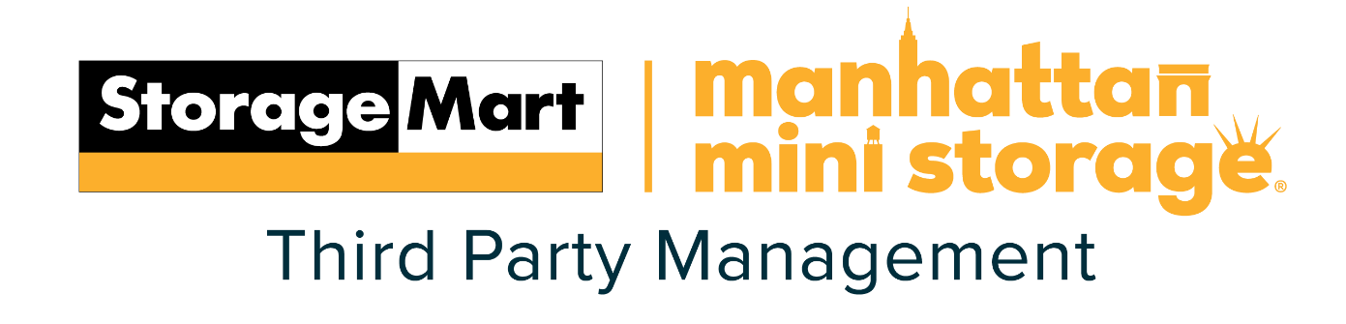
State of the Market
Mike Burnam
President and Chief Investment Officer

Slide 2
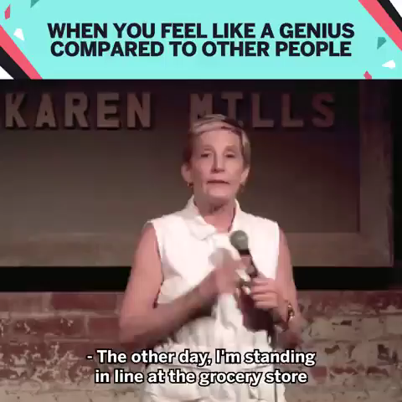
Notes:
He secret about self storage is OUT. If they are talking about it in the grocery line, we have made it to a major food group.

Slide 3
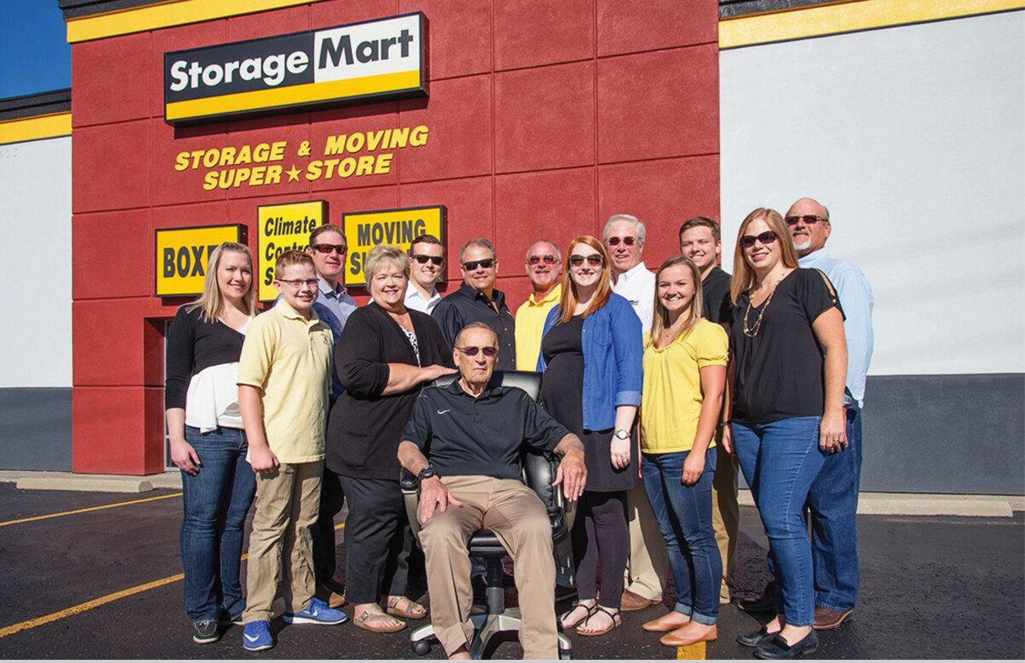
50-year Overnight Success
Notes:
We are a family business. 10 family members +/- all working together, getting along, going to lunch together ( some pretty big tabs) spending holidays together with a group of 50+. a lot of people ask how do you do this???
Great question, not sure we have all of the answers but it begins with sweeping units and growing from there. A requirement you work outside the family 2 years before coming back. An understand each of us have different expertise and responsibilities, and understanding that not all are created equal, most importantly willingness to listen.
that does not mean we always get along. DISCUSSIONS< but understand we love each other and love for what is best for the company.

Slide 4
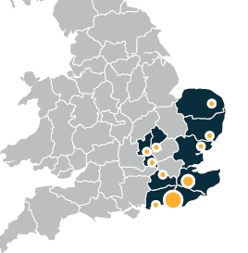
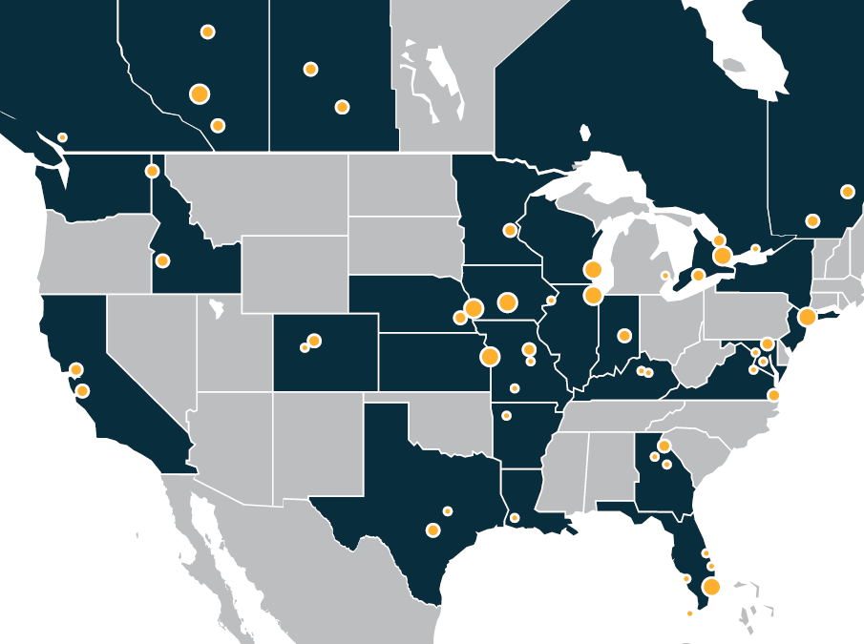



StorageMart
307 Locations
218 Locations
71 Locations
18 Locations
Notes:
We have been big and we have been small, benefits and detriments to both.
We have had private equity, limited partners and no partners. Again benefits and detriments to all.

Slide 5
StorageMart
at a glance
Largest Privately-held self storage owner / operator
Family Operated & headquartered in Columbia, MO
27.4 million NRSF
299,000 units
$7.4 billion market cap
795 employees
307 locations
Operating in 3 countries
Notes:
This is who we are today.
We did not Plan on this happening and in fact we failed many times, sold out of the business 4 times, but have managed to stay afloat and be semi successful

Slide 6
Growth of StorageMart: 1973 - 2024
Manhattan Mini Storage Acquisition (18 Stores)
Big Box Acquisition (14 Stores)
Recap with GIC & Cascade at $2.7B
Safety Storage Acquisition (20 Stores)
InStorage Acquisition
(68 Stores)
IPO 78 Stores
$600M Portfolio Sale
2 Stores
Notes:
This chart is our companies growth over the past 51 years. It goes like this.....we started the same way all of you did, first facility 1973.
Sold for first time 1986, started with 2 stores, Family came back into business.
Built company up went public 1994, effectively sold the company went from 30 LP;'s to thousands of shareholders. Good and bad things to this.
1999 PSA bought the company, third time we sold out of the business
2000 partnered with Warburg Pincus to re-build company, 2006 Warburg wanted their money back, 4th time we sold company
Partnered with high net worth family, grew, took what we learned from PSA and launched a successful takeover of only publicly traded company in Canada, making us the largest company in Canada.
Saw opportunity to buy portfolio n UK, now have 18 stores, we like to buy a critical presence in a market to allow our branding and pricing power to effect positive outcomes.
2020 brought in new partners GIC and Cascade, allowed us to purchase Manhattan mini giving us a $7.3 billion market cap.

Slide 7
Timeline of Past Recessions
1970
Short Lived - Prime Rate 7%
1973–1975
Arab Oil Embargo- Prime Rate 5.5% going to 6.25%
1980–1982
Runaway Inflation – wage and price controls Prime Rate 21.5%
1986
Mini Recession- Accounting rules changed on Depreciation – Prime rate 9.25%
1990–1991
Savings and Loan Crisis Prime Rate 9 going to 10.5%
2001
Dot Bomb – Y2K, 9/11- Prime Rate went from 7.5% to 9% in 7 months
2008-09
Great Recession- Sub Prime Mortgage Crisis - Prime rate started at 7.5% going down to 5.25% in 15 months
2020
Covid Fueled, Economy Collapsed- Fed lowered rates to 0%, Government issues billions in aid.
Sept 2019 Prime = 5%, March 2020 = 3.25%
2024
Maybe Recession - Prime at 8.5%
Notes:
Over the last 50 years there have been 9 recessions. 1980 21% interest, 1986 – change of depreciation rules for accounting, 1990--Savings and Loan Crisis that created the REIT industry, 2001 – DOT bomb and Y2K, 2008 GFC began the dropping of interest rates…are we in store for another?
20% for new development in the 80’s. the
Savings and loan crisis of 1990 and 91 created a huge amount of below replacement real estate
Russian ruble collapse (beginning of the end of us at Storage Trust)
Dot bomb With every down there is a resulting up, however,
nothing has been like the UP we have seen with the COVID three years. this is not the norm as the history shows us and before we know it we will be back to where we were before COVID and that is slow growth of NOI 2-5% too much building and everyone still doing just fine if they remember the past.

Slide 8
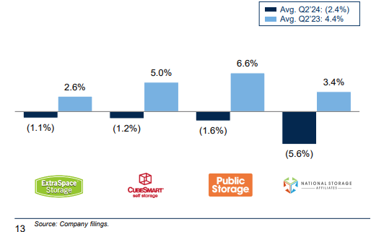
YoY Same Store NOI Growth Rate
Notes:
The most recent year might tell us we are already in a recession. 1994 when we went public, we told the market we would generate 3-5% NOI growth…we did until COVID.

Slide 9
Google Search Demand for Self Storage in the U.S.
2024 is Down by 4.4% compared to 2023
and down 4.8% compared to 2019
Notes:
We are a Google “partner” just mean we spend at least $10 million per year with them…and yes, they are a Monopoly. BING.
Purple was 2020, fantastic year yielding mid double digit NOI growth by public companies, numbers that in my opinion will never happen again.
Note the blue lines, 2019, we are now tracking below 2019 when the world thought we had wayyyy too much supply and public company numbers were beginning to tank. WHY DO WE TALK ABOUT GOOGLE???
Let’s bring this to a local level and look just at Denver

Slide 10
Search for
Self Storage in Denver, CO is down by 21% in 2024, year-over-year
Notes:
In 2019 not shown here DEN was rated as one of the more overbuilt markets reflecting in very low Google Search demand (purple) then COVID hit, everyone was moving to CO.
2021 (green) was FANTASTIC for Colorado, then
2022 (blue)cropped considerably, and now 2024, we are below the bottom year of 2020. WE LOOK FOR CORRELATIONS IN ORDER TO TRACK DEMAND OR DETERMINE WHAT FUTURE DEMAND MIGHT LOOK LIKE

Slide 11







Primary Demand Drivers for Self Storage
Lifestyle
Commercial
Transitional
Notes:
Our business has 3 distinct demand drivers, Lifestyle (NYC), Transitional (new home buyers, moving up or down in life), Commercial…Growth after COVID has been from Commercial as we created many new small businesses and the firwt move out of their garage is into a storage unit.

Slide 12
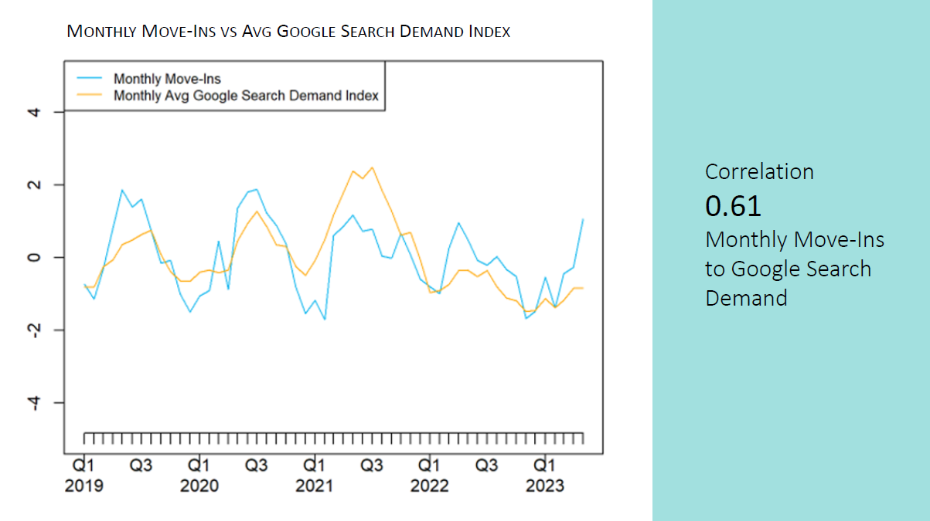
Notes:
This is our internal move in data compared to google search demand for self storage, a direct casual relationship. With demand depressed, our move ins are depressed.

Slide 13
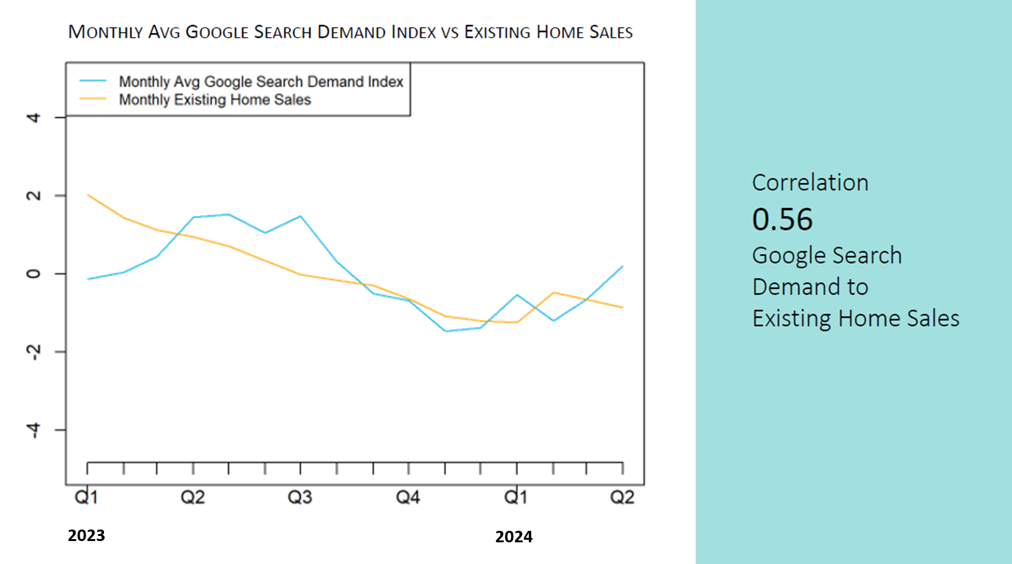
Notes:
And here is google search demand correlated with existing home sales, also highly correlated. Simply put, we are seeing depressed demand for our product because Americans are buying homes at the lowest level in 10 years, as I showed you all earlier. THEN WE ENTERED Q3 2023 AND THE DROP YOUR RATE MOVE BY EXR. Why did they do this, because they saw these numbers and had to protect their occupancy.

Slide 14
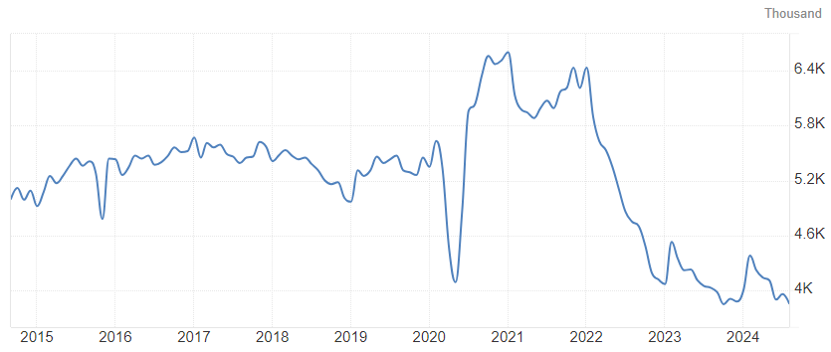
Existing home sales last 10 years
Initial COVID lockdowns
Notes:
US housing transaction volume is currently at the lowest volume seen in the last 10 years, everyone was literally locked inside their homes before the boom occurred and bought at crazy low interest rates. SIMPLY PUT PEOPLE ARE STAYING PUT.
Multi family has had some of the highest renewal rates in history, none of the is good news for storage. People are not moving right now, and it is having a material affect on demand for storage. WHAT IS THE REASON FOR THIS??

Slide 15
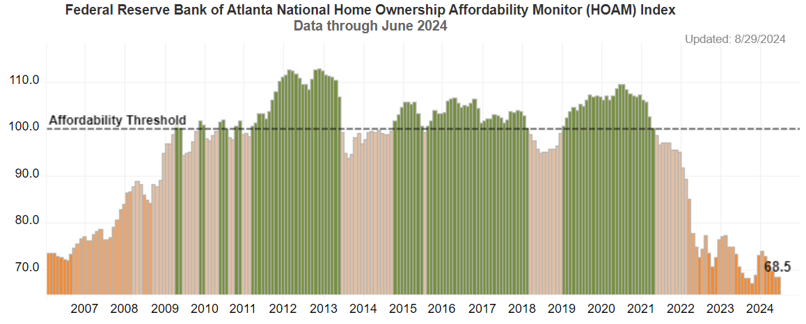
Why aren’t people buying/building houses?
Notes:
The reason is, They cant afford it. The Atlanta Federal Reserve index the Home Ownership Affordability Monitor, measuring ability households to absorb annual costs of owning a median priced home. This is a national view of the affordability of a median home owner from 2006 when they started tracking data to present.
2008-2009 during GFC interest rates when down from 7.% to 5.75% in 15 months. Then we began seeding the economy trying to get it to grow, interest rates went down then affordability went up 2012-2013…more of same 2015-2018…also created a great development opportunity and we expanded…topic of conversation was too much supply 2019 then COVID.
the median home to the median buyer is current less affordable today than it was prior to the financial crisis in 08-09. the lowest it is on record.
By the way, AFTER each of the periods of time we cross into a great home affordability period, our self storage operations boom.

Slide 16
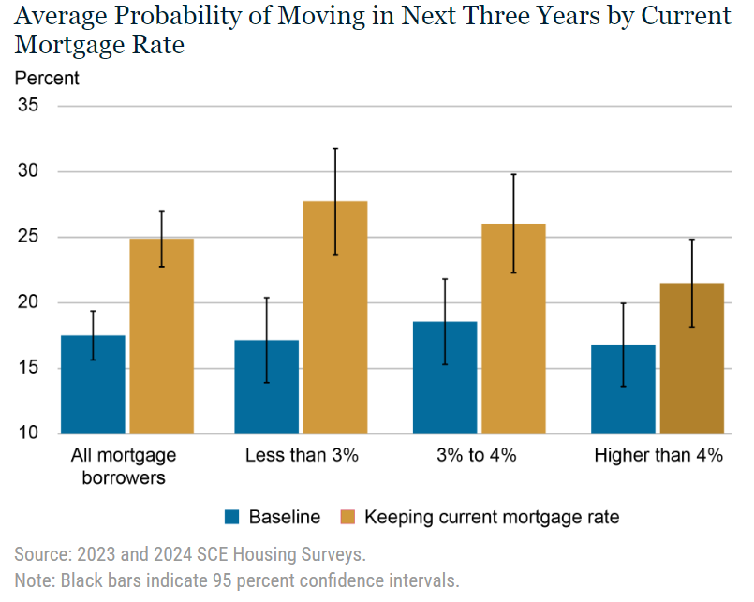
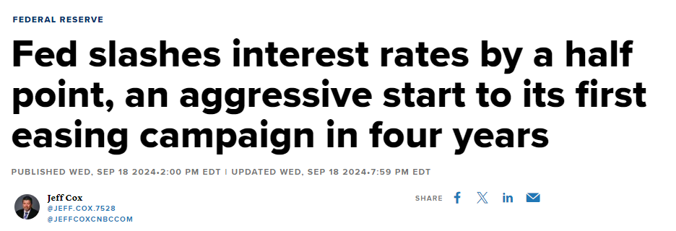
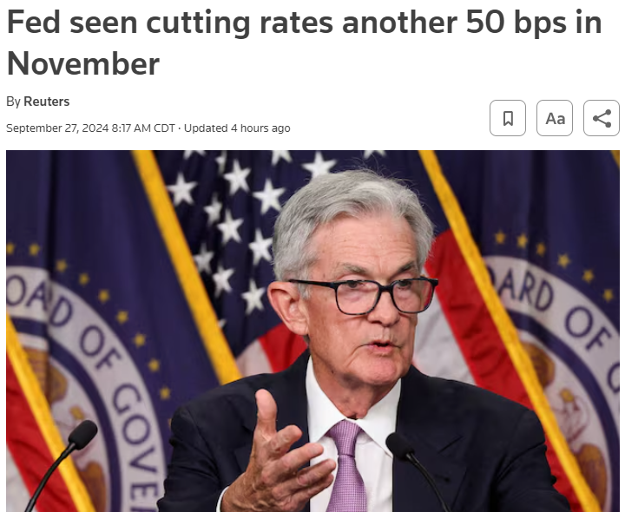

The “Lock In” Effect and Recent Rate Cut
Notes:
The New York Fed conducted a study over the six quarters ended Q2 2024 - asked a key question: if you could keep your existing mortgage rate when buying a new home, would you be more likely to move? The study effectively measured how much higher rates are discouraging moves and how sensitive different groups are to this effect.
Under current conditions, just 16% of homeowners expect to move in the next three years. But if they were allowed to keep their existing rate, that jumps to 23%.
homeowners with mortgage rates below 3%, their baseline moving probability is around 17%, but if they can keep that rate, it jumps to nearly 28%..
those with rates between 3% and 4% show a notable rise from 19% to 26%—about a 40% increase.
But notice the far-right group: homeowners with rates above 4%. Their baseline moving probability is already at 16%, and offering to keep their rate only nudges it to 21%.
Will we get back to 3-4% rates again…..logic and current market conditions tell us, NO. If HO rates stay at the current level, development loans and acquisition loan rates will remain high showing pricing for stores will likewise be lower as cap rates rise.

Slide 17
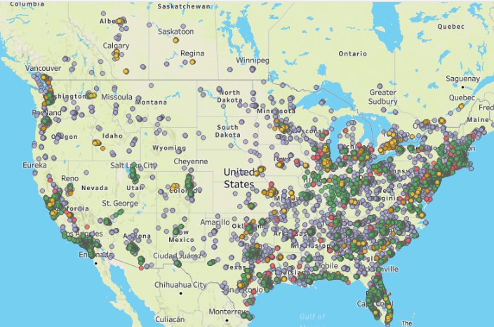
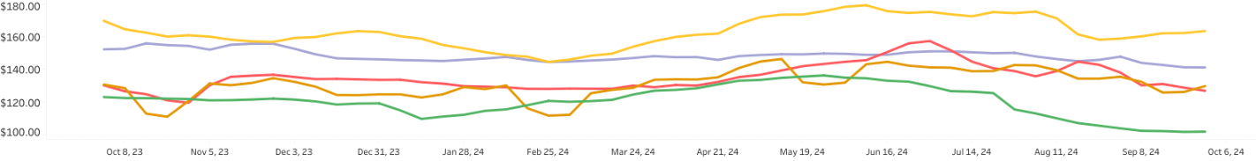
Trailing 12 Month Pricing
Store Count
StorageMart: 276
Extra Space: 2,835
Public: 3,332
CubeSmart: 1,556
Large Independent: 9,758
Total stores web scraped 17,757
Notes:
So what have operators attempted to do when demand went down from the largest user of our product, we instituted rev man schemes, one of which was dropping asking rates to the basement and giving huge rent increases…..every time I try to fight this and prove it wrong, I end up proving it works…WHY –OUR CUSTOMERS ARE VERY STICKY…HOW LONG WILL THIS LAST?
Purple are independents……this is one year of webscraping 10x10’s from over 17,000 facilities.

Slide 18
StorageMart Asking Rates
Correlation Coefficient
2023 0.46
2024 0.70 (+52%)
Notes:
Is GOOGLE search volume really what we should look for….We think so, and have adjusted our revenue management algo’s to reflect this..This is how we look at pricing and how it is emerging and constantly being refined Index of our starting rates on average across the US. IF YOU AR ENOT WORKING Google, you need to b, here is why..

Slide 19
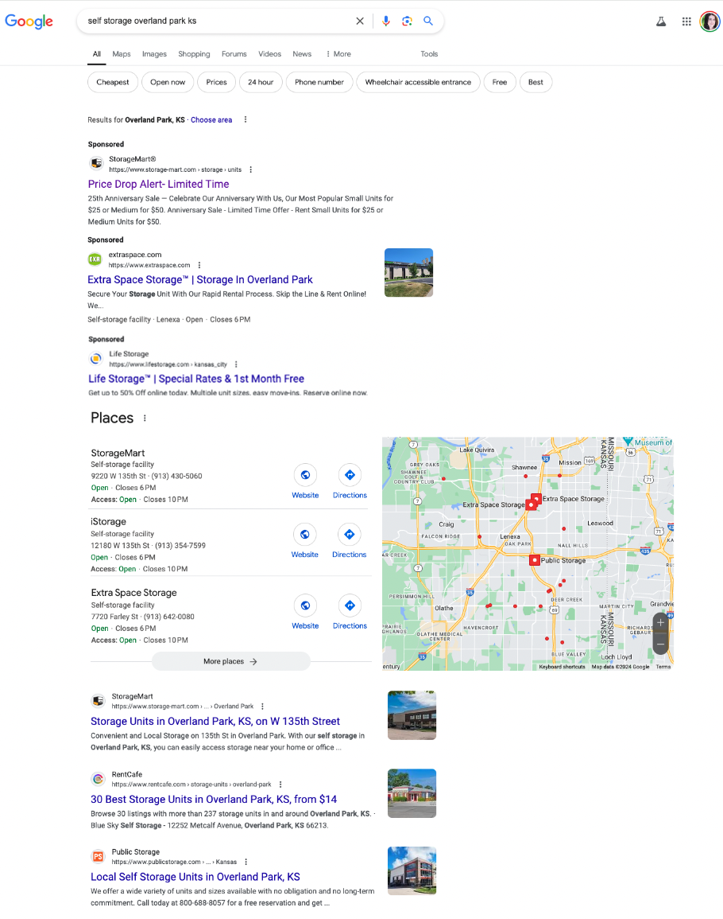

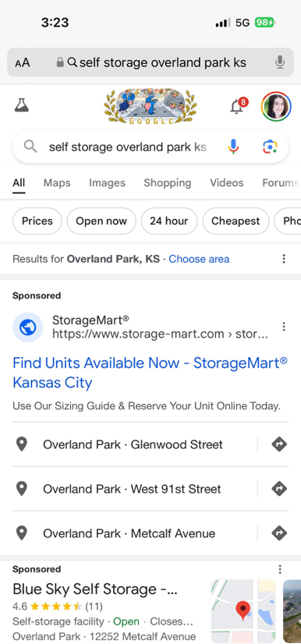
Today, 61% of traffic
comes from mobile.
Google Search Ads
(27% of traffic)
Maps “3Pack”
(42% of traffic)
Traditional Organic
(31% of traffic)
Notes:
LOWERING RATES DOES NOT CREATE NEW DEMAND…IT ONLY SATISFIES EXISTING DEMAND
So we have all gone a biT crazy with cutting asking rents and raising rents after 3-6 mnths, so what do we do…we spend more money on advertising.
Today, our industry has finally managed to understand page one real estate for self storage search-----Ads are expensive-----Maps take endless work-----Organic is non-stop effort
Just when we think we have it all figured out….Google changed their algo’s, our Customers are changing and all of a sudden the new real estate play is the size of your cell phone screen THEN we have voice search which is totally different real estate.

Slide 20
Web Speed
eCommerce
Retailers
- -
eCommerce Retailers: AirBnB, Wikipedia, MidwayUSA
Notes:
Nobody really knows what goes into the total Google algo that says who is at top of Organic listing, but we know some things that do make a difference.
Speed matters to customers and to Google. Nobody does it very well in self-storage. We thought we had it down when we re-did our web page to load in less than 4 seconds, compared to other e-commerce type businesses, we are too slow by half!
This is after we spent $1 million IN 2020 re-doing web site, we are now budgeting spending $1 million per year for constant updates.

Slide 21
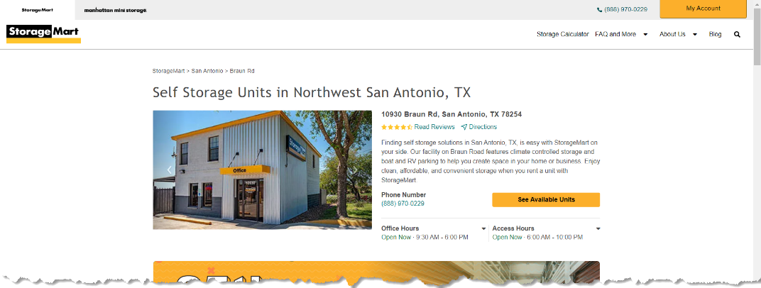
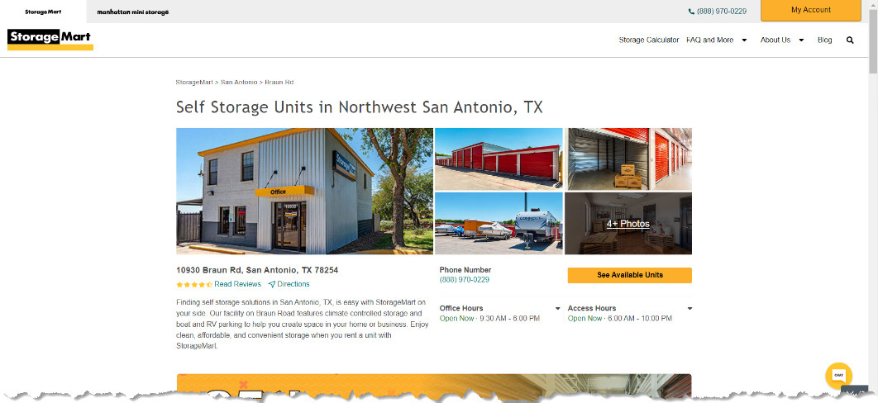
A: Control
2024 eCommerce:
500 updates | 25 A/B tests
Case Study:
23,400
Web Visitors
Results:
Increased web reservations
by 5.73%
B: Variant
WINNER!!!
Notes:
One thing you can do is A-B testing. Here is an example one of the many A/B tests we do each year.
We wanted o know which web presentation generated the most results
The “Variant” has a more engaging photo gallery and improved the conversion rate of which users one the page rent a storage unit by 5.73%. This means we capture more reservations per web user when we use this design.

Slide 22
Advertising Costs as % of Revenue
Notes:
So, if our search demand is down We bringing $500 million in revenue and our marketing costs are about$15 million.

Slide 23









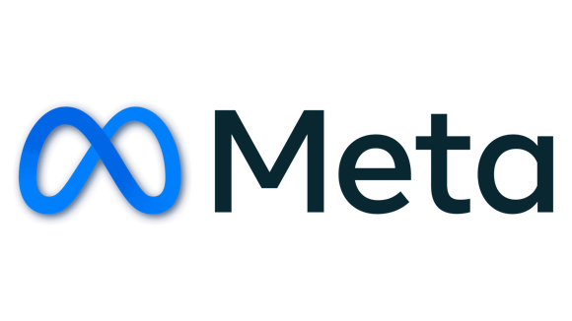

2030 Advertising Predictions:
Fragmenting of Google
Google will drop from 90% to 50% of cost.
Social Media will increase to 20% of cost. (TikTok, Meta, Snapchat, etc.)
“Over-the-Top” channels like Hulu, YouTubeTV, etc will increase to 15% of cost.
AI Assistants, Apple, and other platforms will increase.
Notes:
Google is fragmenting---Gen Z doesn’t even use Google for most search Voice Search…they use Tik Tok or Your tube THEN How is AI assisted search going to change us ?
When someone asks their phone with AI for storage, they will give you directions and only offer up one! Then what do we do
The advertising options 15 yrs ago was YELLOW PAGES, wish we could go back there! The companies that provide search are changing and will continue to change, we must change with them…here is what could happen.

Slide 24









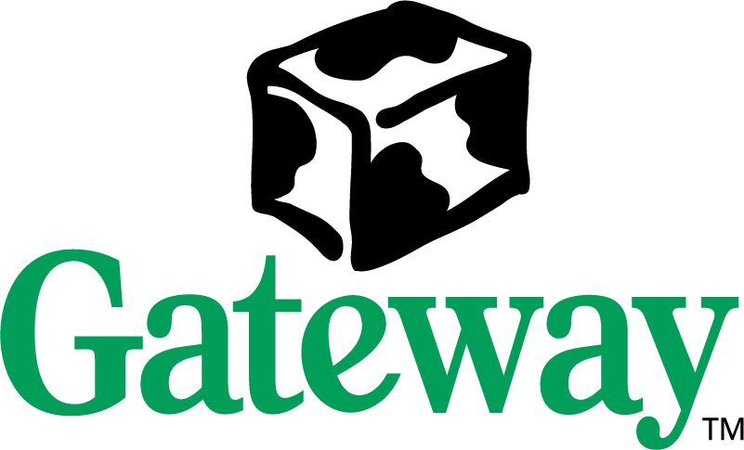




“History does not repeat itself, but most often, it rhymes” ~Mark Twain
2004
2024
$2.3M for 30 second Super Bowl ad
$7M for 30 second Super Bowl ad
What does this have to do with Self Storage?
EVERYTHING!
Notes:
This shows 20 years of change …what happened to Gateway, and Radio Shack, …in 20 years we will know who Crowdstrike is other than what they caused airline programs to crash? If you do not keep up with today and the changes that are being made as to how our customers find us, you might end up being Blockbuster or RadioShack.

Slide 25

Scientific & Educational
SWAG
means
Scientific Wild Ass Guess
Notes:
This is where Experience, Data and Vision all have to come together. Our innovation process frequently is born out of all three of these factors coming together…But Experience and Vision will only take you so far
Here is how we look at things and what we feel are most important. In other words lets get back to basics.

Slide 26

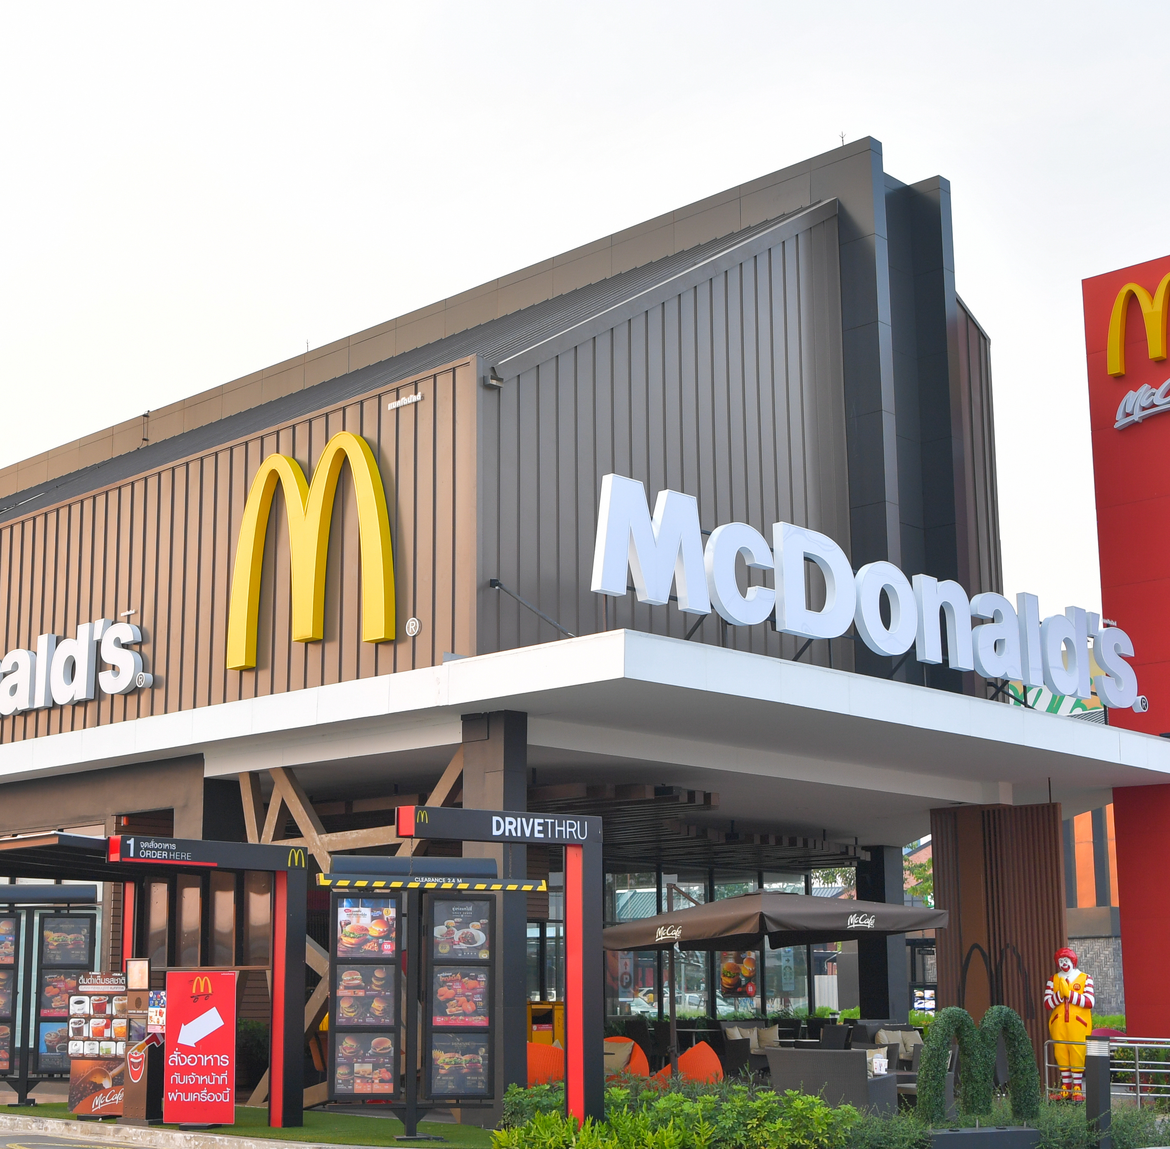
Notes:
If any of you have ever heard me speak before you will know why I put this slide in…..have you ever seen a self storage facility that has failed when you can smell McD and see a Wal mart?
We are still a location driven business. Let’s talk about some of the changes we will see, I will open the corporate kimono a bit here and show you the way we see things.

Slide 27

30% Increase in New Supply
in the Last 5 Years
In 2023, the US Self-storage industry expanded to a staggering 1.7BSF in order to meet the lofty demand caused by pandemic displacements.
Over the last five years, 254.6MSF was added, accounting for 15.1% of total inventory.
In 2022, nearly 39.9MSF of rentable storage was introduced, with 52.5MSF projected for 2023—a 31.8% surge in total supply.
CRE Daily
Aug 18, 2023 Newsletter
Notes:
First…STOP building…in reality, there have been many times over the past years everyone has said this and it never seems to make any difference. During COVID if you had a new store ready to rent ti filled in 12 mnths or less if you followed th principles in the previous slide. New supply is a fact of life, all I can try to do is make sure if/when you do develop, you do it right, in the right locatin and with the right demographics etc.

Slide 28
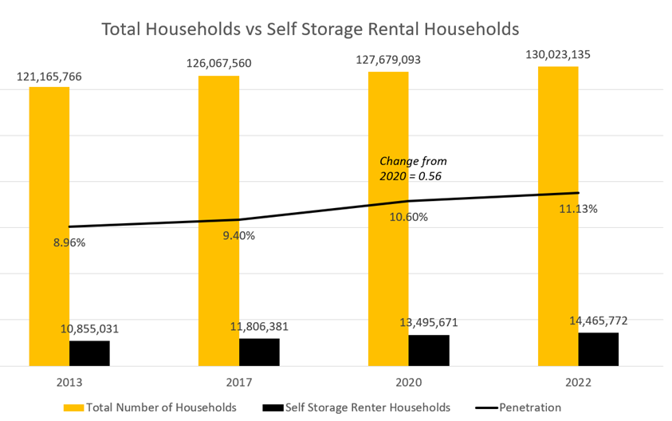
SF/Capita – The right way to evaluate supply?
Notes:
supply will again become a hot button issue again is 7 SF/capita the right number
We think this VERY OLD SCHOOL. and is one of many metrics we look at before buying or developing in a market.
10-11% of US households use self storage. We have hard data on how many people live in our trade areas. We are able to get SF estimated form Yardi and Radius and impute a SF/capita, however, what we lack access to is unit mix data at facilities.
Comparing the Boise and Manhattan markets as extreme examples of population density and unit mix where SF/capita is not an appropriate way to gauge supply. In Boise, ID the MSA average SF/capita is 18.24 SF. Our same store occupancy in Boise today is among the highest of any of our markets today, and materially higher than Manhattan, which only has 3.24 SF/capita of self storage. Conventional wisdom would say that Boise is horrendously oversupplied and Manhattan is very much underserved for self storage, but the opposite is true of both markets.
no national data source that tells you how many storage units at a location. All you can get is an algorithmic estimate of square footage from third party data sources. Large operators have a broad sample of data, due to owning stores in both very dense and very sparsely populated markets. We look at units/capita as the great equalizer.
The average storage unit in Boise is approximately 5 times larger than our average unit in Manhattan. Unit mix sizes are driven by unit size demand in local markets (I will talk more about this in a bit) in a hyper dense markets people want smaller units and vice versa. In Boise, there are enough units to meet 11% household demand, and in Manhattan, enough to meet 9%. By a units/capita measure, Manhattan is only slightly undersupplied, while Boise is actually right at about equilibrium of supply.
What if we used the average unit size at facility to an entire MSA to impute the actual total number of storage units in that market, not the NRSF?
If we assume that 10% of US households (which has been the average over the past 10 years) use storage at any given point in time, the math becomes easier, when we take the number of units over the population in an area to determine a demand ratio based on consumption of actual storage units, not square footage.
This levels the playing field, Manhattan and Boise are actually both right at equilibrium of supply when viewed through this lens, with 9-11% demand for units satisfied. SF/capita is an easy metric to discuss at a macro level, unfortunately we do not yet have a national data set on unit count by facility, so we have to make assumptions on average unit size based on expert experience in a market.

Slide 29
5 Year NOI Growth
Demographics Matter
 | Average Income | Median Income
High | $142K | $110K
Medium | $100K | $70K
Low | $61K | $35K
CAGR
75 stores monitored from 2020 - 2024
Notes:
demographics are important considerations as well. We operate in all types of markets ranging from high income to low income areas, but we have come to recognize that they are not created equally…..

Slide 30
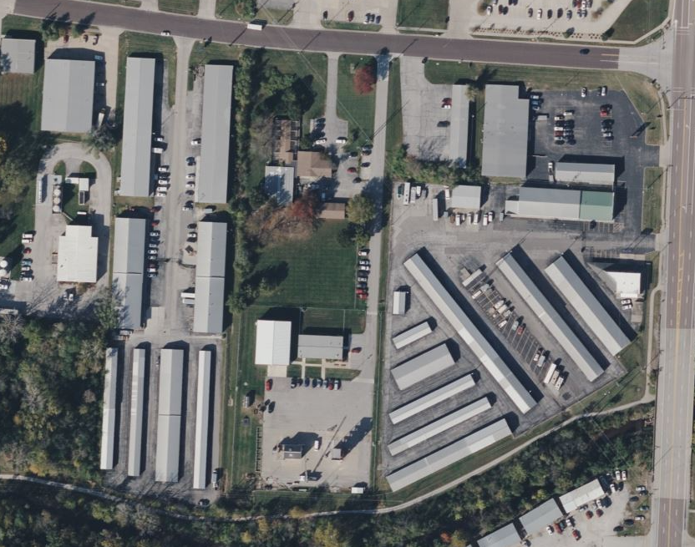
76,000 Sqft Facility:
Over 50 Years of Unit Mix
Unit Size | $ of Units | Total Sqft
Small | 650 | 27,170
Medium | 260 | 30,264
Large | 70 | 15,869
TOTAL | 980 | 73,303
1974
Unit Size | $ of Units | Total Sqft
Small | 126 | 5,267
Medium | 193 | 22,465
Large | 164 | 48,580
TOTAL | 483 | 76,580
2024
Columbia, MO
Notes:
another lesson we have learned about stores over time is that markets shift. This is the first store built by our father in 1974. 50 years ago, this 76,000 ft store had 980 units but today it has 456 units. We have taken a store with a unit size of 77 ft per unit and have turned it into 170 ft per unit. Why would we do that when everyone knows that small units rent for higher dollars per foot? Well…..that might look good on paper but if the market has shifted and small units are no longer in demand, they bring in nothing!

Slide 31
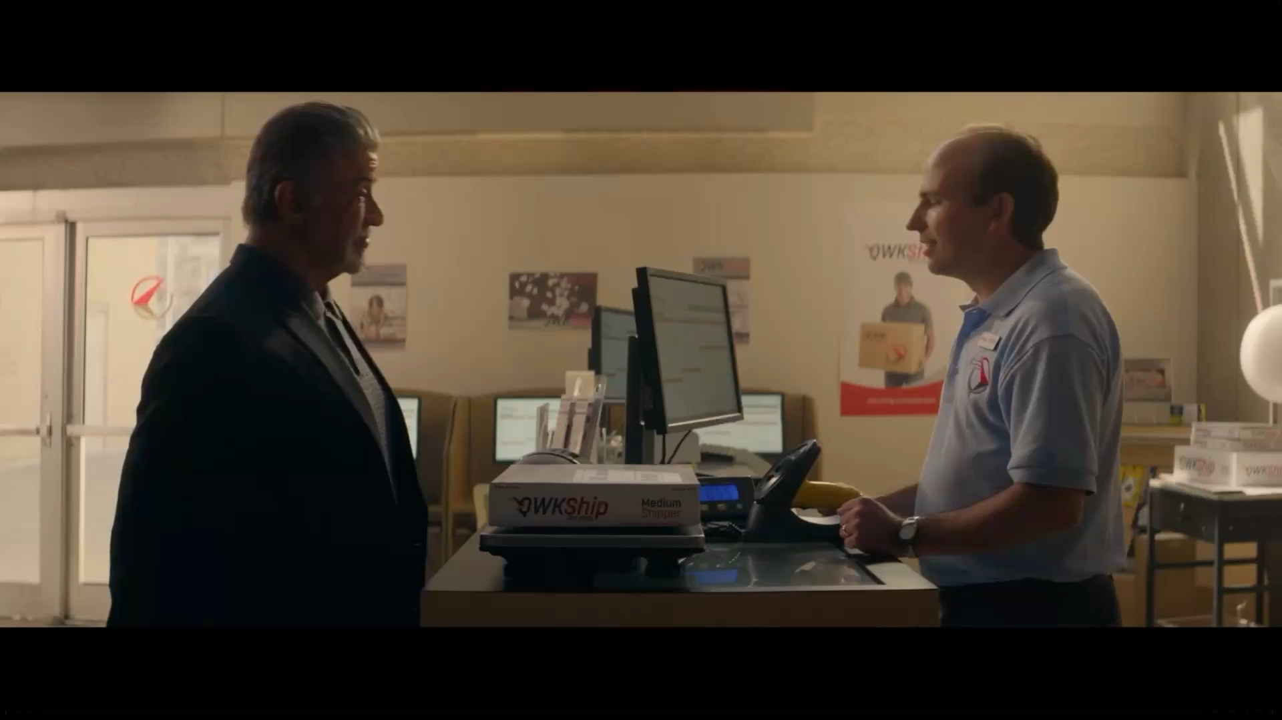

Slide 32




Four Data-Driven Decisions
Analysis of employee and consumer trends illuminated opportunities for efficiency. The results improved customer experience, company culture, and NOI.
Going
Cashless
Overhauling
Overlocks
Auditing
Auctions
Workforce
Optimization
45,000 fewer trips to the bank + 60,000 hours of manager time saved.
Auto-pay enrollment increased.
Theft reduced + increased Accounting efficiency
50% reduction in overlocks.
6% increase in fees collected.
66% reduction in overlock credits given
100,000 hours of manager time saved..
2,000 auctions
26% =$25 or less
44% = $100 or less
15% = Complete Payment
20% overnight reduction in payroll… and growing
Rightsized staffing and policies to perform:
  Walk-in Rentals
  Payment Processing
  Maintenance
  Auctions
Notes:
Important decisions that where data driven
Cashless- no bank runs 300 stores x 3 trips a week save $1.5 annual payroll,
No cash shrinkage, no petty cash reconciliations, no local bank accounts saves us about $1million annually
Overlocks- 50% reduction in overlocks 11,000 per month to 5,500. Locks On/Locks Off. Changed fee structure to later and greater. Vast majority of overlocks are removed when customer pay slightly late.

Slide 33



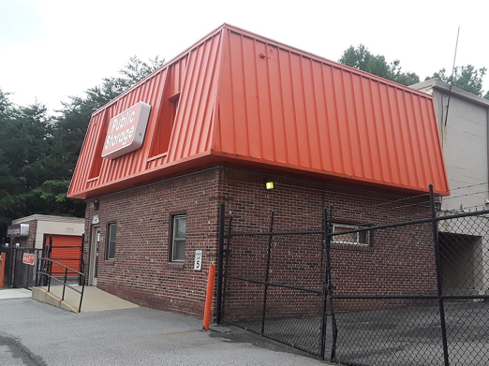
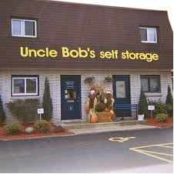
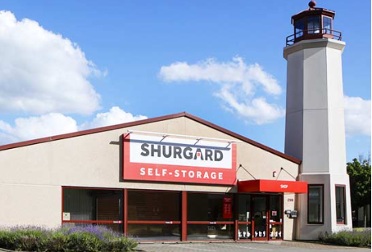
Historical
Brands
Notes:
In the earliest days, Brands did not matter much. Wall Street changed that
84 locations all with different names because we were too cheap to buy new signs but
Wall Street taught us Brands were about raising money.
But nobody was very good at what branding was really all about except for one stand out in the peer group

Slide 34
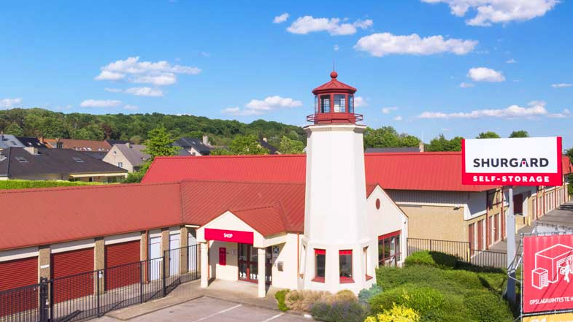
Notes:
These guys were the first to really think about branding unfortunately there were so focused on raising and spending money to brand their stores with lighthouses, they ended up as merger meat for PSA…and now those beautiful lighthouses have been painted orange and look like big traffic cones! But they had something!
A big part of PSA launching a hostile takeover on Shurgard was that they recognized SHUR as a competitive threat and wanted to strangle them in the cradle.
EXR and Life

Slide 35


Notes:
At StorageTrust we were starting to get a notion of branding and were ready to roll out our new image when PSA struck
But Mike and I were very early adherents to ESG movement and were big on recycling….

Slide 36
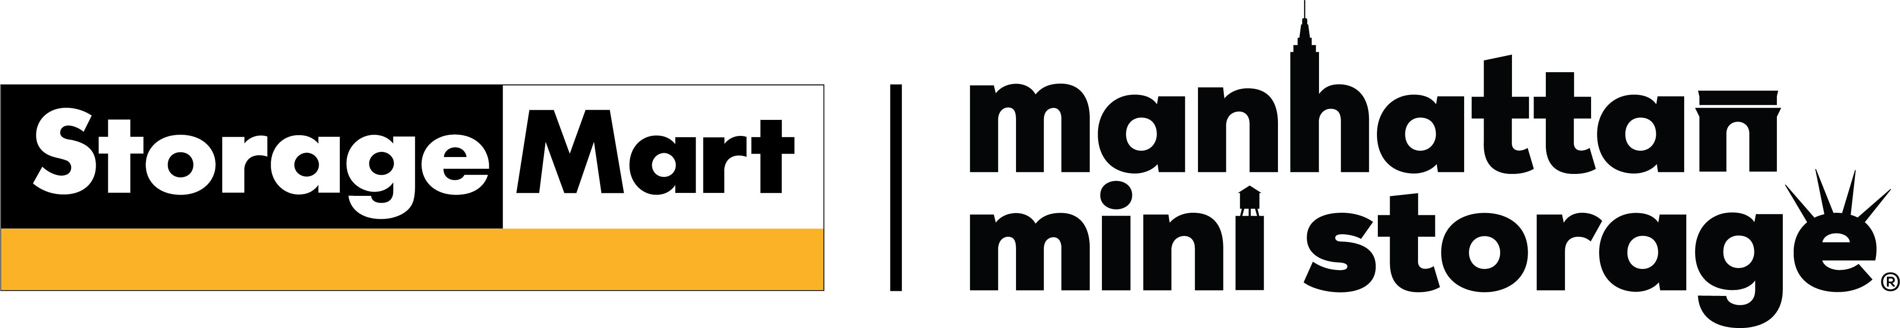
Notes:
Brands are suddenly important to customers, and to digital algorithms

Slide 37
Manhattan Mini Storage by the Numbers
2.1 Million Square Feet
48% market share of NYC self storage market
HHI 64% higher than national average
77% of households are renters
272,000 students within a 3-mile radius
Unit sizes are 66% smaller than the US average at 47sqft
RPSF exceeds $7/month, $84/year
Transaction expense of $112 Million
Notes:
At one time in self storage history we completed or were part of the largest purchase/sales at that time. First in 1986, second 1999, now 2021. not sure if that is good or bad, but it has served us OK up until now.

Slide 38
Rebrand to Manhattan Mini in the Boroughs
Case Study:
January 2024, rebranded 3 locations in Brooklyn & Queens
The Results:
Immediate 57% Increase in Brand Search
Marketing Efficiency:
  Lower CPC in paid ads
  Higher search volume
  More web visitors
Notes:
50 years, Manhattan Mini Storage was exclusively in Manhattan.
January 2024, we rebranded 3 stores to MMS (Brooklyn & Queens) and soon to do NJ stores.
IMMEDIATE increase to MMS branded search – increased by 57%
Benefits include
Lower CPC in Paid Ads
Higher click thru rates on web listings
Higher search volume
More people on our website

Slide 39


Slide 40


Slide 41


Slide 42


Slide 43

Notes:
They have been known to produce many bill boards all over NYC that we now own attached tour stores by putting out rather edgy comments about NYC.

Slide 44
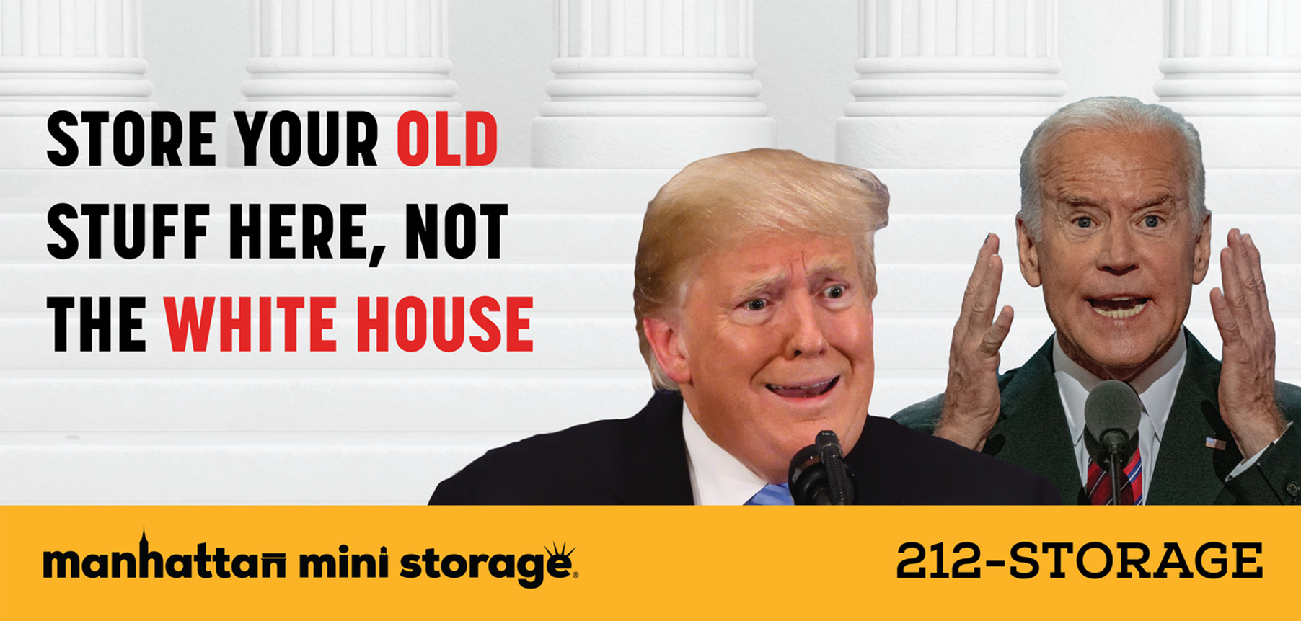

Slide 45
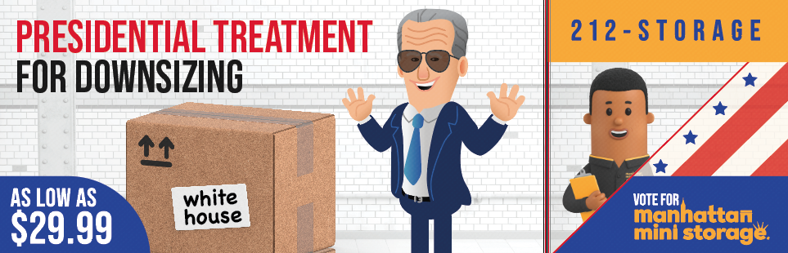
Notes:
NEED TO USE THIS AS A SEGUEY INTO MARKETING THAT USES SCALABILITY

Slide 46
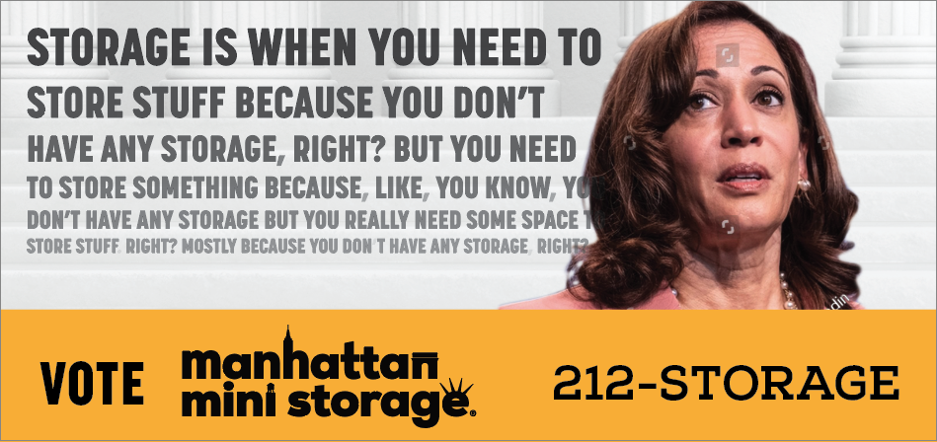
Not ready for prime time

Slide 47
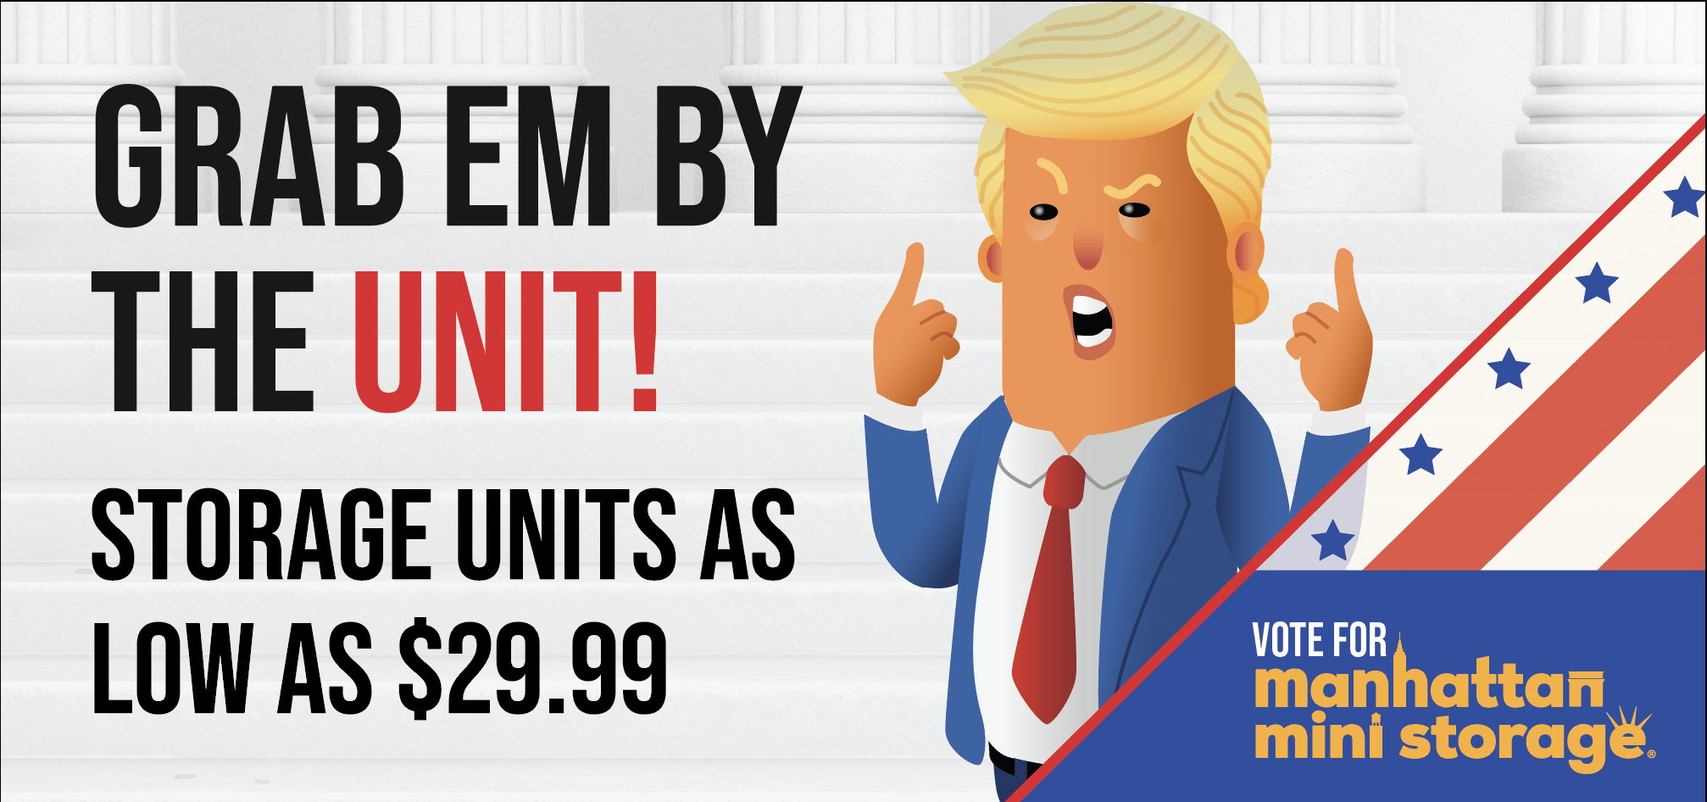
Branding Outtakes

Slide 48

StorageMart
A 50-year Overnight Success
Mike Burnam
Chief Investment Officer & President

