Slide 1


COLORADO SSA
TYSON HUEBNER, YARDI MATRIX

Slide 2

AGENDA
Factors Influencing Storage Demand
Self Storage Q2 REIT Results
Deep Dive Into Storage Street Rates
Historical & Forecasted Supply Trends
Self Storage Transactions

Slide 3
Yardi Matrix Self Storage House View – October 2024
SELF STORAGE FUNDAMENTALS & OUTLOOK
Self storage performance continues its cyclical decline driven by weak demand from home sales, one of the main sources for demand, which remain near a two-decade low and showed little signs of improvement over the summer
Q2 REIT results show occupancy returning to pre-pandemic levels, revenue growth turning negative and NOI growth negative for the last three quarters; occupancy may be bottoming as quarter end occupancy was up YoY
Advertised rental rates were down 4.3% in August, marking two years in a row of year-over-year declines; rent growth has improved from -4.8% in June but down from -4.1% in June
Supply is moving forward as starts have been persistent so far in 2024; forecast calls for a 10% decline in supply in 2024 from 2023, equal to 3.2% of existing supply well-below the long-term average of 4%; mid-to-long forecast has been revised upwards
Transaction volume year-to-date down 33% versus 2023, but a few major portfolio transactions recently show signs of life
Denver, including Boulder, Fort Collins and Greely, has outperformed the nation for several years, as evidenced by higher occupancy and reaccelerating revenue growth from the REITs and above-average advertised rate growth
Colorado Springs has underperformed on revenue and NOI growth, with lower occupancy and below-average advertised rate growth, but recently has shown some signs of improvement with higher occupancy and three months of MoM rate increases
Competition from new supply has fallen significantly in Colorado Springs and Denver which has been a substantial tailwind for performance, particularly in Denver which went from one of the most oversupplied markets in 2017/2018
Sales activity in Colorado Springs and Denver has remained slow, down 60% YTD as of August
Source: Yardi Matrix

Slide 4
FACTORS INFLUENCING
STORAGE DEMAND

Slide 5
Total Population is Increasing Only Modestly, With Immigration Giving a Short-Term Boost in Recent Years (Which CBO Numbers Better Estimate Than the Census)
Source: Yardi Matrix; Moody’s Analytics; U.S. Census Bureau; Congressional Budget Office; “Noncitizen Coverage and Its Effects On U.S. Population Statistics,” J. David Brown, Misty L. Heggeness and Marta Murray-Close (2023)
Notes:
Brittney updated 10/8…Next update: 11/12
"Z:\Matrix\Presentations & Webinars\Slide Deck\03 Demographics\Population\Forecasted Overall Population Growth -Historical included version.xlsx"

Slide 6
Net Immigration Saw a Sharp Uptick in 2022-2023,
But Its Future is Dependent on Political Events
Source: Yardi Matrix; Congressional Budget Office
Notes:
Data as of 1/18/24; no calendar for future updates
https://www.cbo.gov/publication/59697#data
"Z:\Matrix\Presentations & Webinars\Slide Deck\03 Demographics\Migration\Net Immigration - WSJ and CBO projection .xlsx"

Slide 7
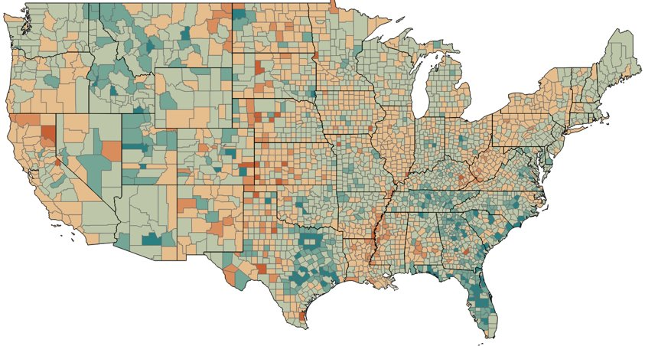
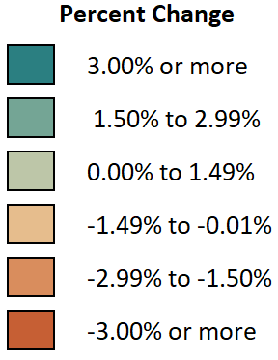
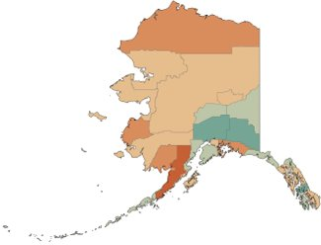

Western and Southern States Have Experienced Significant Population Growth
Percent Change in County Population: July 2022 to July 2023​
CO Counties with Most Population Growth | Population Increase | YoY % Growth
Weld County | 9,176 | 2.6%
Douglas County | 7,969 | 2.1%
Adams County | 5,856 | 1.1%
El Paso County | 3,619 | 0.5%
Larimer County | 3,194 | 0.9%
Denver County | 3,124 | 0.4%
Mesa County | 1,150 | 0.7%
Elbert County | 964 | 3.5%
Fremont County | 702 | 1.4%
Broomfield County | 665 | 0.9%
Source: Yardi Matrix; U.S. Census Bureau, Vintage 2023 Population Estimates
Notes:
Jacob 9/17/24
Z:\MHN_Files\Matrix\Presentations & Webinars\Slide Deck\03 Demographics\Population\Vintage2023Estimates

Slide 8
Home Sales as a Percent of Households is Down to GFC Levels,
Both Nationally and for Colorado Metros
Data through Q3 2024 | CO metros include the combined Colorado Springs, Denver-Aurora-Lakewood, Boulder, Fort Collins and Greeley Metropolitan Statistical Areas Source: Yardi Matrix; Moody’s Analytics
Notes:
Brittney updated 10/8…next update: 11/12
M:\Matrix\Presentations & Webinars\Slide Deck\03 Demographics\Home Sales as % of Households

Slide 9
Multifamily Rent Growth Has Been Mixed With the Northeast
& Midwest Outperforming and the Sunbelt Underperforming
Data as of August 2024 | Source: Yardi Matrix
Notes:
Jacob 9/16/24
M:\Matrix\Presentations & Webinars\Slide Deck\02 Multifamily\Rent and Occupancy\YOY Top 30 Multifamily Markets
Workbook
Workbook:
Matrix Monthly Metro Data (email)
Filter for National and YoY RentOverall
Add new data to other workbook
Update dates and data range
Check 10-year average by manually taking average of last 10 years of National YoY Rent Overall (workbook, should be month by month)

Slide 10
Sunbelt Markets Are Leading Multifamily Absorption as a % of Current Stock
Market | 2024 YTD Completions | Completions as % Stock | Absorption % Current Stock
Phoenix | 11,211 | 3.1% | 3.6%
Charlotte | 7,813 | 3.5% | 3.5%
Raleigh-Durham | 7,391 | 3.9% | 3.5%
Orlando | 9,035 | 3.3% | 3.4%
Columbus | 3,337 | 1.7% | 3.0%
Nashville | 5,743 | 3.1% | 3.0%
Austin | 10,573 | 3.5% | 2.9%
Indianapolis | 3,149 | 1.7% | 2.9%
Las Vegas | 3,046 | 1.6% | 2.6%
CO Springs | 1,287 | 2.7% | 2.4%
Denver | 9,560 | 2.9% | 2.4%
N. New Jersey | 3,311 | 1.2% | 2.3%
Seattle | 7,324 | 2.4% | 2.3%
Dallas | 16,370 | 1.8% | 2.1%
Miami | 8,873 | 2.4% | 2.1%
Market | 2024 YTD Completions | Completions as % Stock | Absorption % Current Stock
Twin Cities | 5,203 | 2.0% | 2.1%
Atlanta | 12,087 | 2.3% | 2.0%
Portland | 5,147 | 2.8% | 2.0%
Tampa | 4,887 | 1.9% | 2.0%
Boston | 4,031 | 1.5% | 1.9%
San Francisco | 5,148 | 1.7% | 1.9%
Chicago | 3,194 | 0.8% | 1.8%
Houston | 10,349 | 1.4% | 1.6%
San Diego | 2,624 | 1.3% | 1.6%
Washington DC | 6,366 | 1.1% | 1.6%
Philadelphia | 4,364 | 1.2% | 1.4%
New York | 4,774 | 0.8% | 1.3%
Detroit | 1,065 | 0.5% | 1.1%
Baltimore | 1,057 | 0.5% | 0.9%
Los Angeles | 4,456 | 0.9% | 0.7%
YTD as of August 2024 | Data for Matrix Multifamily Top 30 markets + Colorado Springs | Source: Yardi Matrix
Notes:
Brittney updated 9/16
Data from Absorption file from Casey
Added CO Springs + Removed Kansas City

Slide 11
Google Trends Shows National Search Interest For Self Storage at an 8-Year Low
Search Interest - T12 Average
Market | Vs. Peak | Jul-24 Rent Growth
Portland | -0.2% | -2.1%
Seattle | -9.5% | -1.7%
Columbus (OH) | -10.7% | -5.2%
Miami | -12.1% | -6.2%
Las Vegas | -13.0% | -3.5%
National | -21.2% | -4.1%
Denver | -26.7% | -3.6%
Boston | -28.5% | -4.6%
Charleston (SC) | -30.2% | -7.0%
Nashville | -31.4% | -2.8%
Austin | -32.7% | -3.6%
San Antonio | -33.0% | -5.9%
Source: Google Trends; Yardi Matrix
Notes:
Tyson 9/17/24

Slide 12
SELF STORAGE Q2 REIT RESULTS

Slide 13
REIT Occupancy is Showing Signs of Bottoming,
an Important Precursor for Rent Growth
Source: Yardi Matrix; Quarterly Financial Supplemental and Form 10-Q/10-K, 2018 to 2024, from storage REITs including:
CubeSmart, Extra Space Storage, National Storage Affiliates, Public Storage
Notes:
M:\Matrix\Presentations & Webinars\Slide Deck\10 Self Storage\REIT\Occupancy Index

Slide 14
Occupancy in Denver Did Not Drop as Much as the U.S.,
Stabilized Sooner, Remains Near 94%
Source: Yardi Matrix; Quarterly Financial Supplemental and Form 10-Q/10-K, 2018 to 2024, from storage REITs including:
CubeSmart, Extra Space Storage, National Storage Affiliates, Public Storage
Notes:
Tyson 9/17/24

Slide 15
REIT Revenue Growth Turned Negative in Q2 2024 For the First Time Since Q3 2020
Data through Q2 2024 | Source: Yardi Matrix; Quarterly Financial Supplemental and Form 10-Q/10-K, 2018 to 2024, from storage REITs including:
CubeSmart, Extra Space Storage, National Storage Affiliates, Public Storage
Notes:
M:\Matrix\Presentations & Webinars\Slide Deck\10 Self Storage\REIT\Average Revenue Growth Long-Term

Slide 16
Denver Has Experienced Stronger Revenue Growth Than the U.S. Since 2021
Data through Q2 2024 | Source: Yardi Matrix; Quarterly Financial Supplemental and Form 10-Q/10-K, 2018 to 2024, from storage REITs including:
CubeSmart, Extra Space Storage, National Storage Affiliates, Public Storage
Notes:
Tyson 9/17/24

Slide 17
Denver Has Lower NOI Margins Than the U.S. Overall
Source: Yardi Matrix; Quarterly Financial Supplemental and Form 10-Q/10-K, 2018 to 2024, from storage REITs including:
CubeSmart, Extra Space Storage, National Storage Affiliates, Public Storage
Notes:
M: Matrix\Presentations & Webinars\Slide Deck\10 Self Storage\REIT\NOI Margins

Slide 18
Q2 REIT Occupancy Highest on the West Coast and Northeast,
Growth Strongest in West Coast and Southwest Metros
MSA | Q2 2023 | Q2 2024 | YoY Change in Occupancy
Las Vegas, NV | 90.4% | 92.1% | 1.7%
Seattle-Tacoma, WA | 92.5% | 93.5% | 1.0%
Phoenix, AZ | 89.6% | 90.2% | 0.6%
Portland, OR | 91.1% | 91.5% | 0.4%
San Francisco, CA | 94.5% | 94.8% | 0.3%
Sacramento, CA | 93.7% | 94.0% | 0.2%
Philadelphia, PA | 93.0% | 93.1% | 0.1%
Washington DC | 93.9% | 93.9% | 0.1%
New York/New Jersey | 93.4% | 93.2% | -0.2%
Boston, MA | 94.1% | 93.9% | -0.2%
Miami, FL | 93.8% | 93.5% | -0.3%
Denver, CO | 94.1% | 93.8% | -0.3%
Los Angeles, CA | 94.7% | 94.4% | -0.3%
MSA | Q2 2023 | Q2 2024 | YoY Change in Occupancy
Charleston, SC | 94.4% | 94.0% | -0.4%
Tampa, FL | 92.1% | 91.6% | -0.5%
Austin, TX | 92.0% | 91.5% | -0.5%
Houston, TX | 92.8% | 92.1% | -0.6%
Chicago, IL | 94.2% | 93.3% | -0.9%
Charlotte, NC | 93.5% | 92.6% | -0.9%
San Antonio , TX | 90.2% | 89.2% | -0.9%
San Diego, CA | 93.2% | 92.2% | -1.0%
Nashville, TN | 93.2% | 92.1% | -1.1%
Orlando, FL | 93.8% | 92.0% | -1.8%
Dallas-Ft. Worth, TX | 93.5% | 91.6% | -1.9%
Colorado Springs, CO | 92.4% | 90.1% | -2.3%
Atlanta, GA | 92.2% | 89.6% | -2.6%
Weighted average occupancy | Source: Yardi Matrix; Quarterly Financial Supplemental and Form 10-Q/10-K, 2018 to 2024, from storage REITs including:
CubeSmart, Extra Space Storage, National Storage Affiliates, Public Storage
Notes:
Claire updated 9/12 (removed Columbus OH; added CO Springs)
M:\Matrix\Presentations & Webinars\Slide Deck\10 Self Storage\REIT\REIT Summaries\2024\Q2 2024\Self Storage Metro Statistics
PORTAL: Reports -> SelfStorage -> Institutional Reports -> Self Storage REIT Summary

Slide 19
REITs Have Been Pushing Street Rates Down Since Mid-2022,
Recently Having an Impact on Realized Rates
Matrix street rates = annualized average street rate per sq. ft. for stabilized properties at 36 months after completion, for the following unit sizes:
5x5, 5x10, 10x5, 5x15, 15x5, 10x10, 10x20, 20x10, 10x30 & 30x10 CC and NCC units| Source: Yardi Matrix; Quarterly Financial Supplemental and
Form 10-Q/10-K, 2018 to 2024, from storage REITs including: CubeSmart, Extra Space Storage, National Storage Affiliates, Public Storage
Notes:
M:\Matrix\Presentations & Webinars\Slide Deck\10 Self Storage\REIT\Street Rates and REIT Annualized Rents Quarterly
Tyson

Slide 20
DEEP DIVE INTO STORAGE
STREET RATES

Slide 21
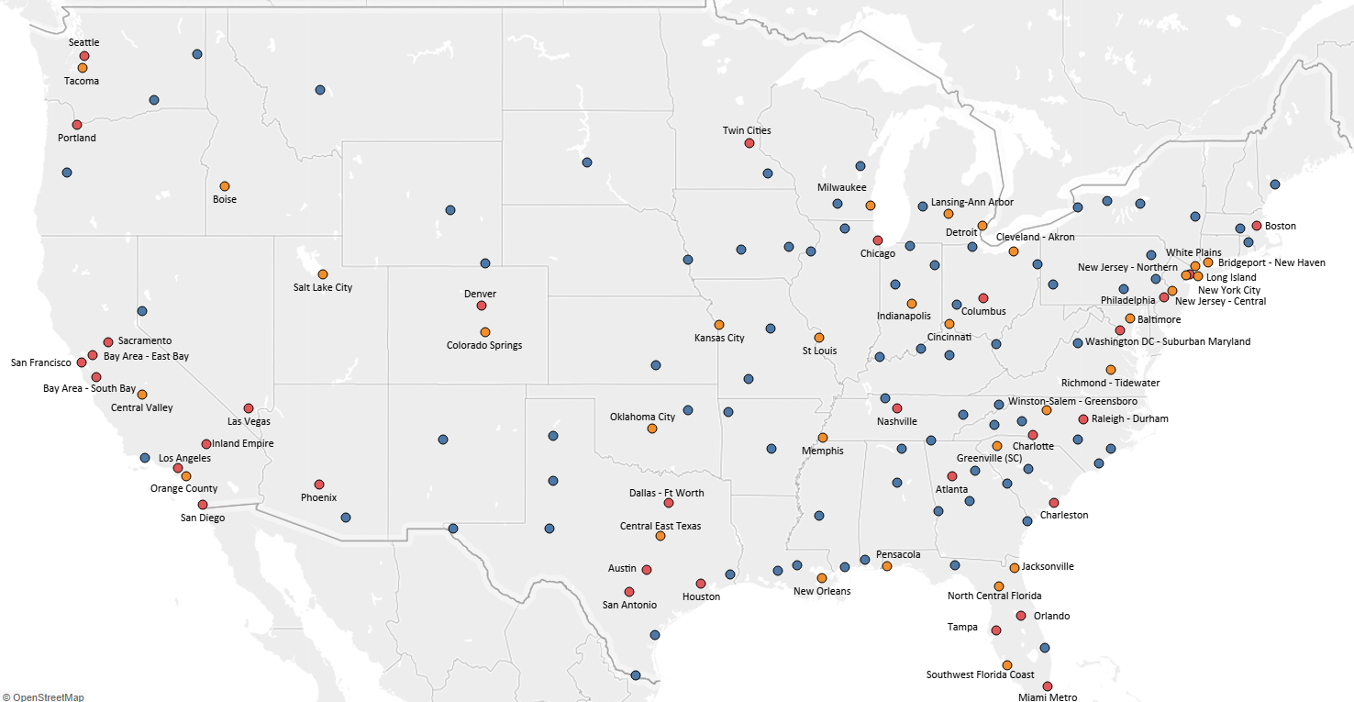
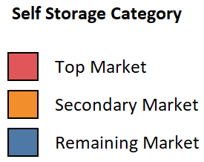
Yardi Matrix Storage Market Classifications
Alaska and Hawaii markets not included on map | Source: Yardi Matrix
Notes:
Jacob 9/13/24
Z:\MHN_Files\Matrix\Presentations & Webinars\Slide Deck\10 Self Storage\Market Lists\Self Storage Market Classification 2024

Slide 22
Annualized Street Rates Peaked in 2022, But Have Continued to Moderate
 | All Units | Non-Climate Controlled | Climate-Controlled
Annualized Street Rates Per Sq Ft: Aug '24 | $16.31 | $15.31 | $17.77
Same-Store Year-Over-Year: Aug ‘23 – Aug '24 | -4.3% | -3.8% | -5.1%
Same-Store Pre-Pandemic to Current: Feb ’20 – Aug '24 | 6.0% | 6.4% | 5.5%
Street rate growth = annualized average street rate per sq. ft. for same-store properties stabilized at 36 months after completion, for the following unit sizes:
5x5, 5x10, 10x5, 5x15, 15x5, 10x10, 10x20, 20x10, 10x30 & 30x10 CC and NCC units| Source: Yardi Matrix
Notes:
Iulia update 09/12
M:\Matrix\Presentations & Webinars\Slide Deck\10 Self Storage\Street Rates\National Rates\National Street Rates
Annualized average street rate per sq. ft. for 5x5, 5x10, 10x5, 5x15, 15x5, 10x10, 10x20, 20x10, 10x30 & 30x10 units / Simple average of the unit sizes/types / Convert to annualized number (multiply monthly rent per sq. ft. by 12) / Stabilized at 36 months / RV/Boats are excluded
Workbook

Slide 23
Rate Growth Worsened in August for All Unit Types,
and Climate-Controlled Units Still Lag Non-Climate-Controlled
Source: Yardi Matrix
Notes:
Claire 9/12/24
M:\Matrix\Presentations & Webinars\Slide Deck\10 Self Storage\Street Rates\National Rates\YOY Same-Store Rent Growth - All units, CC, NCC

Slide 24
Nationally, Month-Over-Month Street Rate Growth was
Negative in July and August After Three Months of Positive Growth
Street rate growth = annualized average street rate per sq. ft. for same-store properties stabilized at 36 months after completion, for the following unit sizes:
5x5, 5x10, 10x5, 5x15, 15x5, 10x10, 10x20, 20x10, 10x30 & 30x10 CC and NCC units| Source: Yardi Matrix
Notes:
Claire 9/13/24
M:\Matrix\Presentations & Webinars\Slide Deck\10 Self Storage\Street Rates\National Rates\Street Rate Growth Month-Over-Month
Data from Self Storage Monthly Report (email)
National Historical Rent Data worksheet
MoM Annualized (Note that the graph will need to select a different range of data if in a new year)

Slide 25
Annualized Street Rates in Denver are Dipping Below Typical Seasonal Patterns
 | All Units | Non-Climate Controlled | Climate-Controlled
Annualized Street Rates Per Sq Ft: Aug '24 | $16.99 | $15.98 | $18.49
Same-Store Year-Over-Year: Aug ’23 – Aug '24 | -3.6% | -2.8% | -4.8%
Same-Store Pre-Pandemic to Current: Feb ’20 – Aug '24 | 9.7% | 9.7% | 9.8%
Street rate growth = annualized average street rate per sq. ft. for same-store properties stabilized at 36 months after completion, for the following unit sizes:
5x5, 5x10, 10x5, 5x15, 15x5, 10x10, 10x20, 20x10, 10x30 & 30x10 CC and NCC units| Source: Yardi Matrix
Notes:
Iulia update 09/12
"Z:\Matrix\Presentations & Webinars\Slide Deck\10 Self Storage\Street Rates\National Rates\National Street Rates - Denver Only.xlsx"
Annualized average street rate per sq. ft. for 5x5, 5x10, 10x5, 5x15, 15x5, 10x10, 10x20, 20x10, 10x30 & 30x10 units / Simple average of the unit sizes/types / Convert to annualized number (multiply monthly rent per sq. ft. by 12) / Stabilized at 36 months / RV/Boats are excluded
Workbook

Slide 26
Rate Growth in Denver Worsened in August for All Unit Types, and
Climate-Controlled Units are Still Lagging Non-Climate-Controlled
Source: Yardi Matrix
Notes:
Claire 9/12/24
M:\MHN_Files\Matrix\Presentations & Webinars\Slide Deck\10 Self Storage\Special Packs\CO SSA\CO SSA - YOY Same-Store Rent Growth - All units, CC, NCC

Slide 27
Denver Month-Over-Month Street Rate Growth Turned Negative in August
Street rate growth = annualized average street rate per sq. ft. for same-store properties stabilized at 36 months after completion, for the following unit sizes:
5x5, 5x10, 10x5, 5x15, 15x5, 10x10, 10x20, 20x10, 10x30 & 30x10 CC and NCC units| Source: Yardi Matrix
Notes:
Claire 9/13/24
M:\Matrix\Presentations & Webinars\Slide Deck\10 Self Storage\Special Packs\CO SSA\CO SSA - Street Rate Growth Month-Over-Month - Sept 2024

Slide 28
Annualized Street Rates in Colorado Springs Have Been Falling Over the Past Year
 | All Units | Non-Climate Controlled | Climate-Controlled
Annualized Street Rates Per Sq Ft: Aug '24 | $13.69 | $12.89 | $15.79
Same-Store Year-Over-Year: Aug ’23 – Aug '24 | -4.3% | -3.9% | -5.7%
Same-Store Pre-Pandemic to Current: Feb ’20 – Aug '24 | 0.9% | 0.6% | 1.6%
Street rate growth = annualized average street rate per sq. ft. for same-store properties stabilized at 36 months after completion, for the following unit sizes:
5x5, 5x10, 10x5, 5x15, 15x5, 10x10, 10x20, 20x10, 10x30 & 30x10 CC and NCC units| Source: Yardi Matrix
Notes:
Iulia update 09/12
M:\Matrix\Presentations & Webinars\Slide Deck\10 Self Storage\Street Rates\National Rates\National Street Rates
Annualized average street rate per sq. ft. for 5x5, 5x10, 10x5, 5x15, 15x5, 10x10, 10x20, 20x10, 10x30 & 30x10 units / Simple average of the unit sizes/types / Convert to annualized number (multiply monthly rent per sq. ft. by 12) / Stabilized at 36 months / RV/Boats are excluded
Workbook

Slide 29
August Rate Growth in Colorado Springs Improved Slightly for
Non-Climate-Controlled Units, But Worsened for Climate-Controlled Units
Source: Yardi Matrix
Notes:
Claire 9/12/24
M:\MHN_Files\Matrix\Presentations & Webinars\Slide Deck\10 Self Storage\Special Packs\CO SSA\CO SSA - YOY Same-Store Rent Growth - All units, CC, NCC

Slide 30
Month-Over-Month Street Rate Growth has Been
Positive Over the Last Three Months in Colorado Springs
Street rate growth = annualized average street rate per sq. ft. for same-store properties stabilized at 36 months after completion, for the following unit sizes:
5x5, 5x10, 10x5, 5x15, 15x5, 10x10, 10x20, 20x10, 10x30 & 30x10 CC and NCC units| Source: Yardi Matrix
Notes:
Claire 9/13/24
M:\Matrix\Presentations & Webinars\Slide Deck\10 Self Storage\Special Packs\CO SSA\CO SSA - Street Rate Growth Month-Over-Month - Sept 2024

Slide 31
Operators Are Using Lower Street Rates to Lease Up Properties
Street rates = annualized average street rate per sq. ft. for the following unit sizes: 5x5, 5x10, 10x5, 5x15, 15x5, 10x10, 10x20, 20x10, 10x30 & 30x10 CC and NCC units| Source: Yardi Matrix
Notes:
Iulia update 09/16
M:\Matrix\Presentations & Webinars\Slide Deck\10 Self Storage\Street Rates\National Rates\Street Rate by Year Built

Slide 32
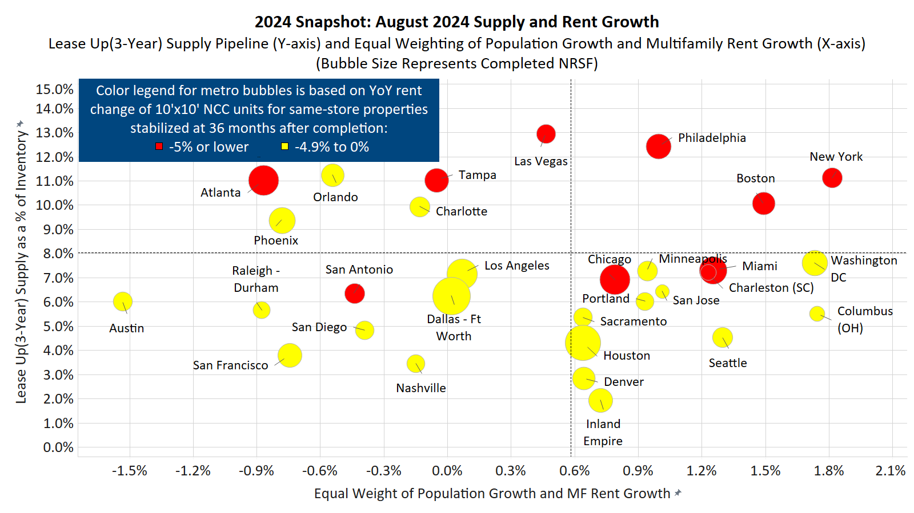
Rent Growth is Weak Among Major Markets, But Those
with Less Lease-up Supply Have Performed Slightly Better
August 2024 supply and rent data | Source: Yardi Matrix
Notes:
Iulia update 09/17
M:\Matrix\Presentations & Webinars\Slide Deck\10 Self Storage\Supply\New Supply and SqFt per Person\Major Markets\Lease Up Supply and Sq Ft Per Person - Major Markets
-Same format & same metros as version used in storage report

Slide 33
Most Top Metros Also Experienced a Decrease in Rents Month-Over-Month
Metro | Same-Store MoM Rent Growth | Same-Store YoY Rent Growth
Washington DC | -0.7% | -1.2%
Nashville | 0.1% | -2.0%
Seattle | -0.4% | -2.4%
Portland | -0.7% | -2.4%
Raleigh - Durham | 0.2% | -3.3%
Los Angeles | -0.5% | -3.3%
San Jose | -1.8% | -3.3%
Sacramento | -0.8% | -3.4%
San Diego | -1.2% | -3.5%
Denver | -0.6% | -3.6%
San Francisco | -0.6% | -3.6%
Houston | 0.2% | -3.9%
New York | -0.8% | -4.2%
Austin | -0.2% | -4.3%
Minneapolis | -0.6% | -4.3%
Metro | Same-Store MoM Rent Growth | Same-Store YoY Rent Growth
Charlotte | -1.0% | -4.4%
Boston | -0.1% | -4.6%
Columbus (OH) | 0.4% | -4.8%
Dallas - Ft Worth | -1.0% | -5.1%
Phoenix | -0.3% | -5.3%
Chicago | -0.1% | -5.4%
Inland Empire | -0.2% | -5.5%
Las Vegas | -1.0% | -5.6%
Orlando | 0.3% | -6.0%
Tampa | -0.4% | -6.4%
San Antonio | -0.8% | -6.4%
Miami | -1.0% | -6.6%
Charleston (SC) | 0.1% | -6.8%
Philadelphia | -1.3% | -6.8%
Atlanta | -0.9% | -10.0%
Data as of August 2024. Street rate growth = annualized average street rate per sq. ft. for same-store properties stabilized at 36 months after completion,
for the following unit sizes: 5x5, 5x10, 10x5, 5x15, 15x5, 10x10, 10x20, 20x10, 10x30 & 30x10 CC and NCC units| Source: Yardi Matrix
Notes:
Kata updated 9/17/24
M:\Matrix\Presentations & Webinars\Slide Deck\10 Self Storage\Street Rates\Street Rate Growth by Market\Street Rate Growth By Market – Top 30 Markets
Workbook

Slide 34
YoY Rate Declines Have Improved in Most Top Metros Compared to Last Year
Gray dashed lines denote national. Data as of August 2024. Street rate growth = annualized average street rate per sq. ft. for same-store properties stabilized
at 36 months after completion, for the following unit sizes:5x5, 5x10, 10x5, 5x15, 15x5, 10x10, 10x20, 20x10, 10x30 & 30x10 CC and NCC units| Source: Yardi Matrix
Notes:
Claire updated 9/13/24
M:\Matrix\Presentations & Webinars\Slide Deck\10 Self Storage\Street Rates\Street Rate Growth by Market\Scatterplot - Current vs 1 Year Ago\Top 30 Scatterplot - YoY Street Rates- Current vs. 1 Yr Ago

Slide 35
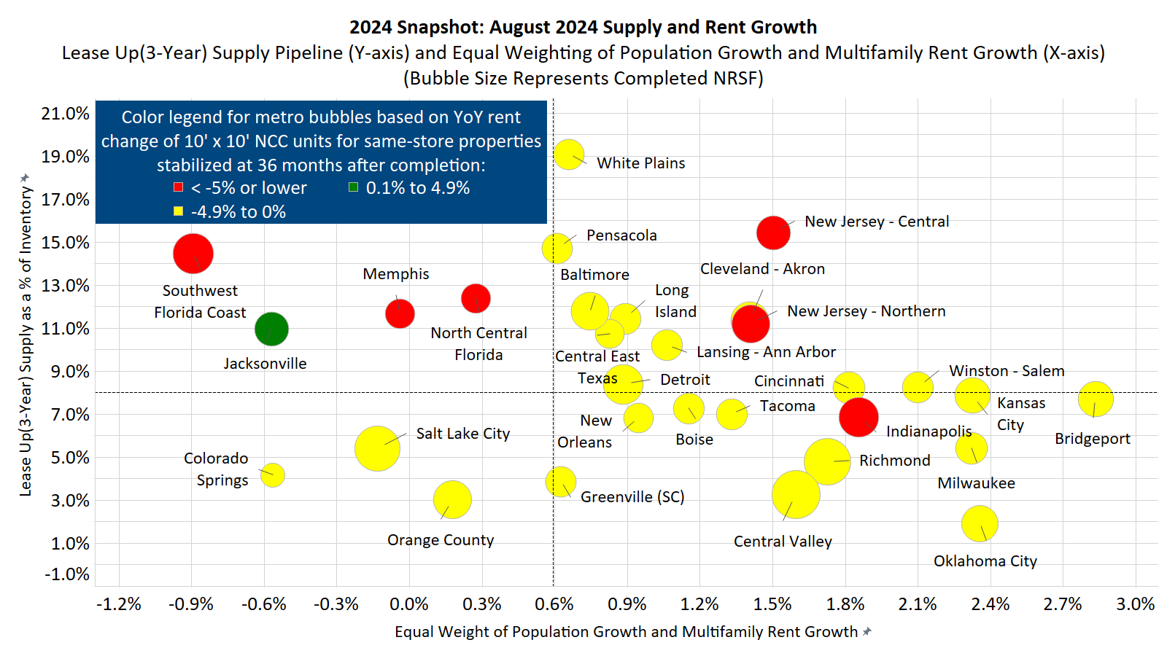
Supply Remains a Concern in Many Secondary Markets,
Demand Not Tied to Strong Multifamily Performance
Secondary markets. August 2024 supply and rent data | Source: Yardi Matrix
Notes:
Iulia update 09/17
M:\Matrix\Presentations & Webinars\Slide Deck\10 Self Storage\Supply\New Supply and SqFt per Person\Tertiary Markets\Lease Up Supply and Sq Ft Per Person - Secondary Markets
- Top 30 Secondary and Tertiary metros based on total NRSF with the top 31 metros filtered out
-Same format as version used in storage report

Slide 36
Secondary Markets are Seeing Similar
Downward Trends in Street Rates as Major Markets
Market | Same-Store MoM Rent Growth | Same-Store YoY Rent Growth
Lansing | 0.1% | 0.2%
Boise | 0.7% | 0.1%
Greenville (SC) | -0.7% | -1.5%
Orange County | -0.1% | -1.6%
Central East Texas | -0.3% | -2.6%
Long Island | -0.4% | -2.8%
New Orleans | 0.2% | -2.9%
Salt Lake City | -0.6% | -3.1%
Jacksonville | 0.1% | -3.1%
Kansas City | -0.3% | -3.2%
Cincinnati | -0.9% | -3.3%
Tacoma | -0.6% | -3.3%
Oklahoma City | -0.2% | -3.4%
Central Valley | -0.3% | -3.8%
Pensacola | -0.8% | -3.8%
Market | Same-Store MoM Rent Growth | Same-Store YoY Rent Growth
Winston-Salem - G. | 0.6% | -4.0%
Detroit | 0.3% | -4.2%
Colorado Springs | 0.5% | -4.3%
Richmond | -0.6% | -4.3%
Cleveland - Akron | -0.2% | -4.5%
N. Central Florida | -0.4% | -4.6%
Bridgeport | -1.2% | -4.7%
Baltimore | -0.5% | -4.7%
White Plains | 0.3% | -4.8%
Indianapolis | 0.2% | -5.1%
Milwaukee | -0.9% | -5.3%
N. New Jersey | -0.4% | -5.4%
Memphis | -1.7% | -7.2%
New Jersey - Central | -0.9% | -7.5%
SW Florida Coast | -0.9% | -9.6%
August 2024 rent data. Street rate growth = annualized average street rate per sq. ft. for same-store properties stabilized at 36 months after completion, for the following
unit sizes: 5x5, 5x10, 10x5, 5x15, 15x5, 10x10, 10x20, 20x10, 10x30 & 30x10 CC and NCC units| Source: Yardi Matrix
Notes:
Kata updated 9/16/2024
M:\Matrix\Presentations & Webinars\Slide Deck\10 Self Storage\Street Rates\Street Rate Growth by Market\Street Rate Growth By Market – Secondary & Tertiary Markets (name updated to Street Rate Growth By Market – Secondary Markets)
- Secondary markets as of Aug 2024 update

Slide 37
Larger Units Performing Better as Development Has Focused on Smaller Units
Street rate growth = annualized average street rate per sq. ft. for same-store properties stabilized at 36 months after completion, for the following unit sizes:
Small = 5x5, 5x10, 10x5, Medium = 5x15, 15x5, 10x10, Large = 10x20, 20x10, 10x30 & 30x10 CC and NCC units| Source: Yardi Matrix
Notes:
Kata updated data 9/13/2024
M:\Matrix\Presentations & Webinars\Slide Deck\Self Storage\Street Rates\Unit Size

Slide 38
Street Rate Summary & Outlook
Following weakened demand and declining occupancy, advertised rate growth has been negative since mid-2022 and recently become a drag on in-place rents
REITs lead the way on advertised rate declines, and markets with the most new supply and REIT management have experienced the biggest declines from peak
Flattening occupancy and easier comparative months in the second half of 2023 could help boost advertised rate growth YoY moving forward
Lease up supply is again a drag on performance and the markets with the most new supply delivered recently have seen the slowest street rate growth
Denver has seen some of the best advertised rate growth recently out of the top 30 markets, while Colorado Springs is showing sign of improvement
Source: Yardi Matrix

Slide 39
HISTORICAL & FORECASTED
SUPPLY TRENDS

Slide 40

NEW STORAGE SUPPLY PIPELINE
PROSPECTIVE
PLANNED
UNDER CONSTRUCTION
LEASE-UP SUPPLY
508 Properties
32MM Total Sq. Ft.
27MM Rentable Sq. Ft.
2,063 Properties
165MM Total Sq. Ft.
153MM Rentable Sq. Ft.
837 Properties
75MM Total Sq. Ft.
63MM Rentable Sq. Ft.
2,038 Properties
182MM Total Sq. Ft.
151MM Rentable Sq. Ft.
Lease-up supply delivered in the trailing 36 months. Data as of August 2024 | Source: Yardi Matrix
Notes:
Claire updated 9/13/24
Lease-Up Supply delivered in the trailing 36 months. Workbook datapoints: Inv-PropertiesT36Completions; Inv-TotalSqFtT36Completions; Inv-RentSqFtT36Completions

Slide 41
After Slowing for Several Years, Completions Slightly Increased in 2023
Following Record Performance in 2021 and 2022
Source: Yardi Matrix
Notes:
Brittney updated 8/2; Data as of July/Q3 2024 portal update
M:\Matrix\Presentations & Webinars\Slide Deck\10 Self Storage\Supply\National Supply Overview\National Annual Completions and Avg Cycle Times

Slide 42
Conversions and Expansions Have Been a
Smaller Part of the Development Picture
Data as of September 2024 | Source: Yardi Matrix
Notes:
Iulia update 09/16
M:\Matrix\Presentations & Webinars\Slide Deck\10 Self Storage\Supply\Completions\Completions by Build Type\National Storage Completions by Build Type

Slide 43
2024 Storage Completions are Trailing Last Year’s Pace
YEAR | COMPLETIONS
2019 | 1,513
2020 | 1,283
2021 | 1,222
2022 | 1,131
2023 | 1,166
2024 YTD | 658
Data as of September 2024. Includes conversions and expansions. The default for unknown completion month is distributed evenly throughout the year | Source: Yardi Matrix
Notes:
Iulia update 09/16
M:\Matrix\Presentations & Webinars\Slide Deck\10 Self Storage\Supply\Completions\Storage Completions

Slide 44
Supply in Lease-Up Has Been Declining Since 2020 But Flattened in the Last Year
Lease-up supply delivered in the trailing 36 months | Source: Yardi Matrix
Notes:
Brittney updated 9/12 with data from workbook
M:\Matrix\Presentations & Webinars\Slide Deck\10 Self Storage\Supply\National Supply Overview\3-Year Rolling Supply by Month

Slide 45
In Denver, Supply in Lease-Up Has Significantly Declined
Since 2020, But Ticked Up Slightly in Recent Months
Lease-up supply delivered in the trailing 36 months | Source: Yardi Matrix
Notes:
Brittney updated 9/12 with data from workbook
"Z:\Matrix\Presentations & Webinars\Slide Deck\10 Self Storage\Supply\National Supply Overview\3-Year Rolling Supply by Month - September 2024 - Denver only.xlsx"

Slide 46
In Colorado Springs, Supply in Lease-Up Has Been Declining
Since 2020 But Has Been Flat in Recent Months
Lease-up supply delivered in the trailing 36 months | Source: Yardi Matrix
Notes:
Brittney updated 9/12 with data from workbook
"Z:\Matrix\Presentations & Webinars\Slide Deck\10 Self Storage\Supply\National Supply Overview\3-Year Rolling Supply by Month - September 2024 - CO Springs only.xlsx"

Slide 47
Majority of Lease-Up Supply in Major Markets Was Delivered <1 Year Ago
Market | Lease-Up % of Existing Inventory
Las Vegas | 12.9%
Philadelphia | 12.4%
Orlando | 11.5%
Atlanta | 11.1%
New York | 11.1%
Tampa | 11.0%
Charlotte | 10.2%
Boston | 10.1%
Phoenix | 9.4%
Washington DC | 7.8%
Miami | 7.3%
Minneapolis | 7.3%
Charleston (SC) | 7.2%
Los Angeles | 7.1%
Chicago | 6.9%
Market | Lease-Up % of Existing Inventory
Raleigh - Durham | 6.8%
Dallas - Ft Worth | 6.4%
San Jose | 6.4%
San Antonio | 6.3%
Austin | 6.0%
Portland | 6.0%
Columbus (OH) | 5.5%
Sacramento | 5.3%
San Diego | 4.8%
Seattle | 4.5%
Houston | 4.3%
San Francisco | 3.8%
Nashville | 3.4%
Denver | 2.8%
Inland Empire | 1.9%
Lease-up supply delivered in the trailing 36 months. Data as of August 2024 | Source: Yardi Matrix
Notes:
Iulia update 09/16
M:\Matrix\Presentations & Webinars\Slide Deck\10 Self Storage\Supply\National Supply Overview\Lease Up\Lease Up Supply as a % of Existing Inventory

Slide 48
Nearly All of the Top Metros Have Seen a Decrease in Lease-up Supply Since 2021
Gray dashed lines denote national. Lease-up supply delivered in the trailing 36 months as a % of existing inventory. Data as of August 2024 | Source: Yardi Matrix
Notes:
Claire updated 9/13/24
M:Matrix\Presentations & Webinars\Slide Deck\10 Self Storage\Supply\National Supply Overview\Lease Up\Lease Up Scatterplot - Current vs 3 Yr Ago\Top 30 Scatterplot - Lease Up - Current vs. 3 Yr Ago

Slide 49
Secondary Markets on the East Coast Have the Most Lease-Up Supply
Market | Lease-Up % of Existing Inventory
White Plains | 19.0%
New Jersey-Centr. | 15.4%
SW Florida Coast | 14.8%
Pensacola | 14.7%
N. Central Florida | 13.6%
Memphis | 12.2%
Baltimore | 11.7%
Long Island | 11.4%
Cleveland - Akron | 11.4%
N. New Jersey | 11.2%
Jacksonville | 10.9%
Central East Texas | 10.7%
Lansing-Ann Arbor | 10.2%
Cincinnati | 8.5%
Bridgeport | 8.4%
Market | Lease-Up % of Existing Inventory
Detroit | 8.4%
Winson-Salem | 8.2%
Kansas City | 7.9%
Boise | 7.3%
Tacoma | 6.9%
Indianapolis | 6.9%
New Orleans | 6.8%
Milwaukee | 5.4%
Salt Lake City | 5.4%
Richmond | 4.8%
Colorado Springs | 4.2%
Greenville (SC) | 3.9%
Central Valley | 3.7%
Orange County | 3.0%
Oklahoma City | 2.4%
Top 30 Secondary markets based on total NRSF. Lease-up supply delivered in the trailing 36 months. Data as of August 2024 | Source: Yardi Matrix
Notes:
Iulia update 09/18
M:\Matrix\Presentations & Webinars\Slide Deck\10 Self Storage\Supply\National Supply Overview\Lease Up\Lease Up Supply as a % of Existing Inventory
Make sure that the Major Markets are filtered out from list (some markets categorized as a major market & a secondary market)

Slide 50
There Has Been a Substantial Uptick in the Number of
Abandoned Storage Projects Over the Past Several Months
Source: Yardi Matrix
Notes:
Kata updated 9/12/2024
M:\Matrix\Presentations & Webinars\Slide Deck\10 Self Storage\Supply\Abandoned Projects\Abandoned Self Storage Counts

Slide 51
New Supply Pipeline: Where Is New Supply Concentrated?
Under Construction (27.3%)
Planned (60.7%)
Prospective (12.0%)
Top 10 Markets | NRSF | UC as a % of Existing Stock
Columbia MO | 214,845 | 14.8%
Athens | 628,460 | 13.7%
N. Central Florida | 1,081,692 | 9.5%
Harrisburg | 770,868 | 9.3%
SW Florida Coast | 1,900,349 | 8.9%
Little Rock | 733,678 | 8.9%
Savannah | 515,844 | 8.7%
South Bend | 375,323 | 8.5%
Port St. Lucie | 534,098 | 8.5%
Hickory | 176,480 | 7.7%
Top 10 Markets | NRSF | Planned as a % of Existing Stock
SW Florida Coast | 6,736,343 | 31.7%
Port St. Lucie | 1,548,789 | 24.6%
Tallahassee | 697,214 | 21.7%
New Jersey - Cent. | 3,134,473 | 21.6%
White Plains | 2,411,142 | 20.0%
Athens | 870,880 | 18.9%
N. Central Florida | 2,056,659 | 18.0%
Las Vegas | 3,168,051 | 15.4%
Philadelphia | 5,347,647 | 15.0%
Jacksonville | 2,228,964 | 14.9%
Top 10 Markets | NRSF | Prospective as a % of Existing Stock
Port St. Lucie | 527,536 | 8.4%
Albany | 522,407 | 7.2%
New Jersey - Cent. | 1,037,296 | 7.1%
White Plains | 790,555 | 6.5%
Long Island | 794,705 | 6.5%
Columbia MO | 88,650 | 6.1%
Iowa City | 134,865 | 5.4%
Honolulu | 152,000 | 5.3%
SW Florida Coast | 1,117,757 | 5.3%
Tampa | 1,522,705 | 4.7%
Data as of September 2024 | Source: Yardi Matrix
Notes:
Kata updated 9/16/2024
M:\Matrix\Presentations & Webinars\Slide Deck\10 Self Storage\Supply\Development Composition\Storage Development Composition

Slide 52
Heavy Under Construction Pipelines in Major Markets in the Sunbelt
Market | UC % of Existing Inventory
Orlando | 6.8%
Sacramento | 6.1%
Philadelphia | 5.8%
Phoenix | 5.7%
Charlotte | 5.6%
San Antonio | 4.9%
Tampa | 4.5%
Miami | 4.5%
Atlanta | 4.1%
New York | 4.0%
Los Angeles | 4.0%
Boston | 4.0%
Seattle | 3.7%
San Francisco | 3.3%
Columbus (OH) | 3.1%
Market | UC % of Existing Inventory
Nashville | 3.0%
Houston | 2.9%
Charleston (SC) | 2.8%
Washington DC | 2.8%
Las Vegas | 2.8%
Inland Empire | 2.7%
Dallas - Ft Worth | 2.6%
Portland | 2.6%
Austin | 2.4%
Raleigh - Durham | 2.2%
San Diego | 2.0%
Chicago | 1.5%
Denver | 1.2%
Minneapolis | 1.1%
San Jose | 0.0%
Yardi Matrix top 30 storage markets. Data as of August 2024 | Source: Yardi Matrix
Notes:
Iulia update 09/16
M:\Matrix\Presentations & Webinars\Slide Deck\10 Self Storage\Supply\Under Construction\Major Markets UC Percent of Stock

Slide 53
Only Twelve of the Top Markets Have Seen a Decrease in
Their Construction Pipelines From a Year Ago
Gray dashed lines denote national. Data as of August 2024 | Source: Yardi Matrix
Notes:
Claire updated 9/13/24
M: Matrix\Presentations & Webinars\Slide Deck\10 Self Storage\Supply\Under Construction\UC Scatterplot - Current vs 1 Year Ago\Top 30 Scatterplot - UC Percent of Stock - Current vs. 1 Yr Ago

Slide 54
Development Activity Continues in Secondary Markets in Sunbelt and Northeast
Market | UC % of Existing Inventory
N. Central Florida | 9.5%
SW Florida Coast | 8.9%
Bridgeport | 7.2%
Jacksonville | 5.8%
N. New Jersey | 5.7%
Tacoma | 4.8%
New Jersey-Centr. | 4.3%
Boise | 4.1%
Richmond | 3.9%
Kansas City | 3.7%
Detroit | 3.3%
Central Valley | 3.2%
Cleveland-Akron | 3.2%
White Plains | 3.1%
Colorado Springs | 2.8%
Market | UC % of Existing Inventory
Long Island | 2.8%
Baltimore | 2.7%
Indianapolis | 2.7%
Winston-Salem | 2.5%
Pensacola | 2.5%
Oklahoma City | 1.8%
Central East Texas | 1.5%
Milwaukee | 1.4%
Lansing-Ann Arbor | 1.0%
Cincinnati | 1.0%
Greenville (SC) | 0.8%
Salt Lake City | 0.4%
Memphis | 0.0%
New Orleans | 0.0%
Orange County | 0.0%
Top 30 Secondary markets based on total NRSF. Data as of August 2024| Source: Yardi Matrix
Notes:
Iulia update 09/16
M:\Matrix\Presentations & Webinars\Slide Deck\10 Self Storage\Supply\Under Construction\Secondary + Tertiary Markets UC Percent of Stock
Make sure that the Major Markets are filtered out from list (some markets categorized as a major market & a secondary market)

Slide 55
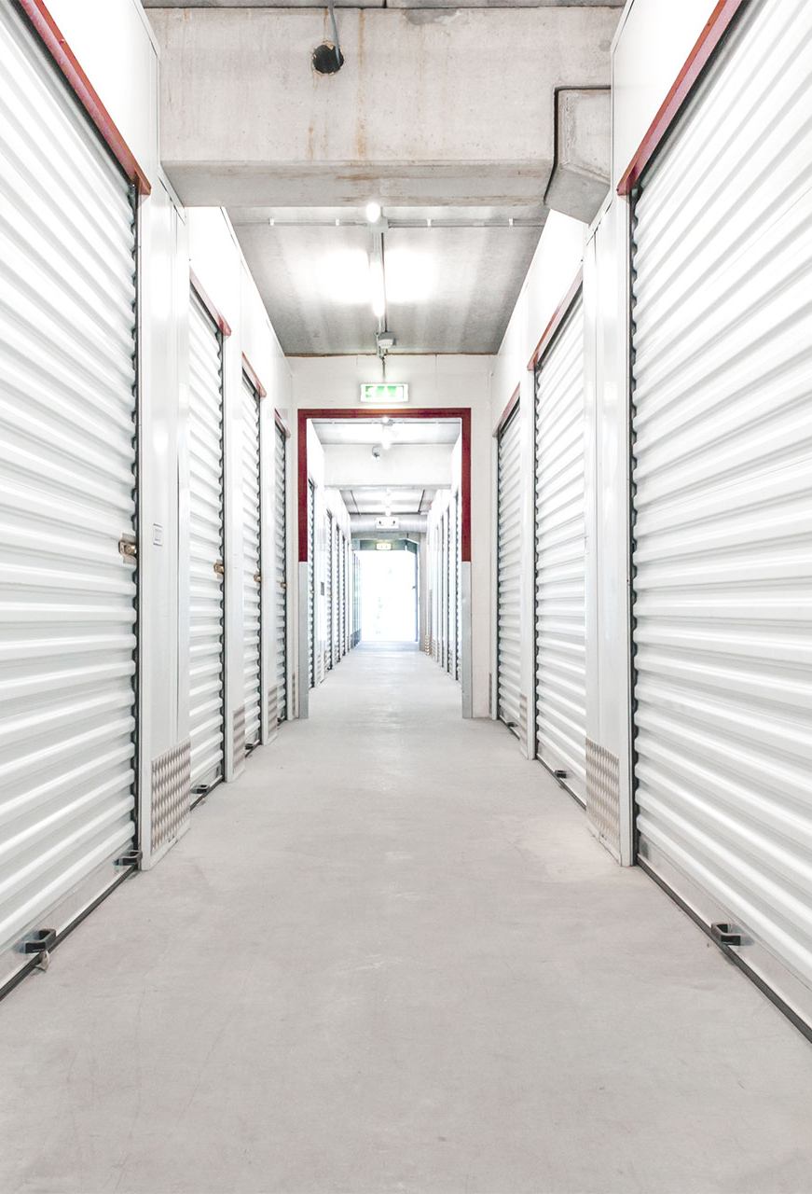
Takeaways From Our Q3 2024
Self Storage Supply Forecast
  The Q3 2024 Yardi Matrix Self Storage supply forecast has increased for all years to accommodate our expanded market coverage
    However, our overall view of future development activity remains unchanged
  Construction starts declined again in Q1 2024 to 11.8 mm NRSF. This is the second straight quarter-over-quarter decline after peaking in Q3 2023
  We continue to expect development activity to decline in 2024:
    The under-construction pipeline was nearly flat in Q2 2024, growing just 1.01% quarter-over-quarter
    Both the planned and prospective pipelines declined quarter-over-quarter as more projects move to an abandoned status
    The three-month moving average of monthly abandoned projects increased to 60. This series bottomed in late 2022 at seven projects per month
Source: Yardi Matrix

Slide 56
The Average Number of Days Spent in the Planned and Under Construction Phases
of Development Remain High and Approximately On Par with Last Year’s Levels
Source: Yardi Matrix
Notes:
Brittney updated with Ben data on 9/19
M:\Matrix\Presentations & Webinars\Slide Deck\10 Self Storage\Supply\National Supply Overview\Avg Cycle Times Chart

Slide 57
Completions Are Forecasted to Decrease Slightly in 2024, And
The Percent Of Stock Will Remain Below The Long-Term Average
Source: Yardi Matrix
Notes:
Claire updated; Data as of 9/19/24 with data from Ben
"Z:\Matrix\Presentations & Webinars\Slide Deck\10 Self Storage\Supply\National Supply Overview\National Completions and Average Cycle Times Q3 2024.xlsx"

Slide 58
Denver’s Completions Are Forecasted to Remain Low in 2024 Through 2029
Source: Yardi Matrix
Notes:
Claire updated; Data as of 9/19/24 with data from Ben
M:\MHN_Files\Matrix\Presentations & Webinars\Slide Deck\10 Self Storage\Special Packs\CO SSA\National Completions Colorado Self Storage

Slide 59
Colorado Springs’ Completions Are Forecasted to Be Elevated in 2025
Source: Yardi Matrix
Notes:
Claire updated; Data as of 9/19/24 with data from Ben
M:\MHN_Files\Matrix\Presentations & Webinars\Slide Deck\10 Self Storage\Special Packs\CO SSA\National Completions Colorado Self Storage

Slide 60
New Supply Summary & Outlook
Supply in lease-up (delivered in the last three years) has been declining nationwide over the few years but flattened recently, led by secondary and remaining markets
The under construction pipeline has remained relatively flat in 2024 although abandoned projects have increased
Development activity is expected to decline in 2024 from 2023 due to lower advertised rates, slower lease up and a more difficult financing environment
Supply as a percent of stock is forecasted to remain below the long-term average and continue to drop over the forecast period, which should help fundamentals stabilize
Denver has seen very little recently delivered supply and supply should remain well below-average, while Colorado Springs could see a slight pickup in deliveries
Source: Yardi Matrix

Slide 61
SELF STORAGE TRANSACTIONS

Slide 62
Sales Activity Has Picked Up Recently But 33% Behind Last Year At This Time
Sales volume estimated based on average price per net rentable square foot by class
Data as of 8/20/24. Sales before property completion and entity sales are excluded | Source: Yardi Matrix
Notes:
Tyson

Slide 63
Colorado Has Seen Similar Trends to U.S. but Well Behind Last Year’s Volume
Sales volume estimated based on average price per net rentable square foot by class
Data as of 8/20/24. Sales before property completion and entity sales are excluded | Source: Yardi Matrix
Notes:
Tyson 9/17/24

Slide 64
Pricing Has Dropped in Recent Years Due to Lower Rents and
Fewer Class A Property Sales in Major Markets
YEAR | STORES SOLD PER YEAR
2020 | 1,034
2021 | 2,116
2022 | 1,801
2023 | 817
2024 YTD | 399
Sales volume estimated based on average price per net rentable square foot by class
Data as of August 2024. Sales before property completion and entity sales are excluded | Source: Yardi Matrix
Notes:
Tyson updated 8/20/24
M:\Matrix\Presentations & Webinars\Slide Deck\Self Storage\Transactions\All Markets - Transactions by Class_tys

Slide 65
Denver Pricing Very Similar to US
Colorado Springs Pricing Trails US but Has Improved
YEAR | STORES SOLD PER YEAR
2020 | 26
2021 | 52
2022 | 52
2023 | 29
2024 YTD | 8
Sales volume estimated based on average price per net rentable square foot by class
Data as of August 2024. Sales before property completion and entity sales are excluded | Source: Yardi Matrix
Notes:
Tyson updated 9/17/24

Slide 66
Yardi Matrix Self Storage House View – October 2024
SELF STORAGE FUNDAMENTALS & OUTLOOK
Self storage performance continues its cyclical decline driven by weak demand from home sales, one of the main sources for demand, which remain near a two-decade low and showed little signs of improvement over the summer
Q2 REIT results show occupancy returning to pre-pandemic levels, revenue growth turning negative and NOI growth negative for the last three quarters; occupancy may be bottoming as quarter end occupancy was up YoY
Advertised rental rates were down 4.3% in August, marking two years in a row of year-over-year declines; rent growth has improved from -4.8% in June but down from -4.1% in June
Supply is moving forward as starts have been persistent so far in 2024; forecast calls for a 10% decline in supply in 2024 from 2023, equal to 3.2% of existing supply well-below the long-term average of 4%; mid-to-long forecast has been revised upwards
Transaction volume year-to-date down 33% versus 2023, but a few major portfolio transactions recently show signs of life
Denver, including Boulder, Fort Collins and Greely, has outperformed the nation for several years, as evidenced by higher occupancy and reaccelerating revenue growth from the REITs and above-average advertised rate growth
Colorado Springs has underperformed on revenue and NOI growth, with lower occupancy and below-average advertised rate growth, but recently has shown some signs of improvement with higher occupancy and three months of MoM rate increases
Competition from new supply has fallen significantly in Colorado Springs and Denver which has been a substantial tailwind for performance, particularly in Denver which went from one of the most oversupplied markets in 2017/2018
Sales activity in Colorado Springs and Denver has remained slow, down 60% YTD as of August
Source: Yardi Matrix

Slide 67

THANK YOU
Feel free to contact me with any questions
Tyson Huebner | 773-415-4672 | Tyson.Huebner@Yardi.com

Slide 68
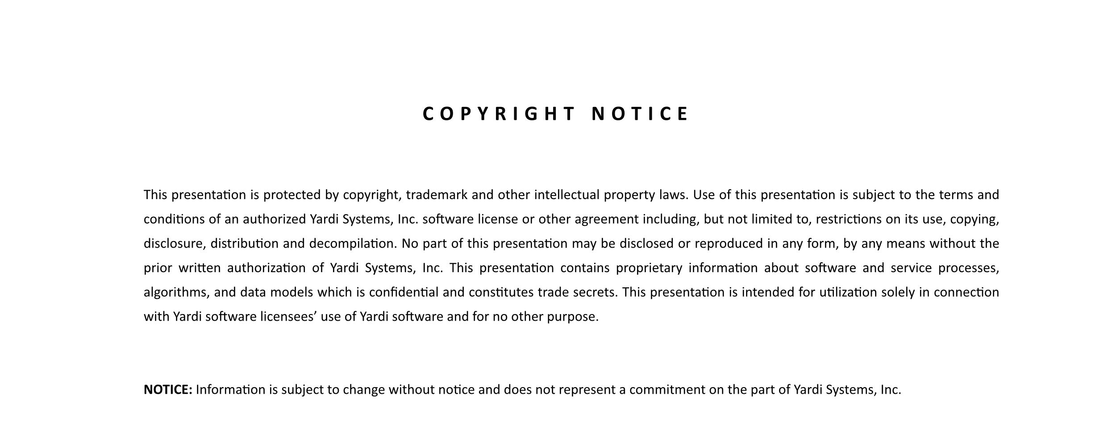

©2024 Yardi Systems, Inc. All Rights Reserved. Yardi, the Yardi logo, and all Yardi product names are trademarks of Yardi Systems, Inc. All other products mentioned herein may be trademarks of their respective companies.
Notes:
Please note this slide NOT editable.
Please notify the corporate design team of any necessary updates to this slide.

Slide 69

Notes:
Please note this slide NOT editable.
Please notify the corporate design team of any necessary updates to this slide.
Used for economic update presentations only.

